Slide 1

INTRODUCTION & KEY LEARNING OUTCOMES
EASY
ADVANCED

Slide 2
KEY LEARNING OUTCOMES
Understand Amazon SageMaker components and overall architecture.
Learn how to build and train a simple machine learning model using Amazon SageMaker Canvas.
Go over Amazon SageMaker Demo/Walkthrough.
Learn how to write your first code in SageMaker notebooks.
Learn about Amazon SageMaker Studio key capabilities.
Run a demo of a trained model in the AWS SageMaker marketplace.
Final Capstone Project

Slide 3
AMAZON SAGEMAKER
BUILD
SageMaker offers data labeling service
TRAIN
Manage environments for training
DEPLOY
Prebuilt available notebooks with state of the art algorithms on AWS marketplace
Hyperparameters optimization for model tuning
Train models using EC2 instances (on-demand and spot)
Easily deploy and scale models
Autoscaling with 75% savings
Amazon SageMaker is a fully-managed machine learning workflow platform that provides services on data labeling, model building, training, tuning and deployment.
SageMaker allows data scientists and developers to build scalable AI/ML models easily and efficiently.
Models could be deployed in production at a much faster rate and with a fraction of the cost.
Let’s explore SageMaker: https://aws.amazon.com/sagemaker/#

Slide 4


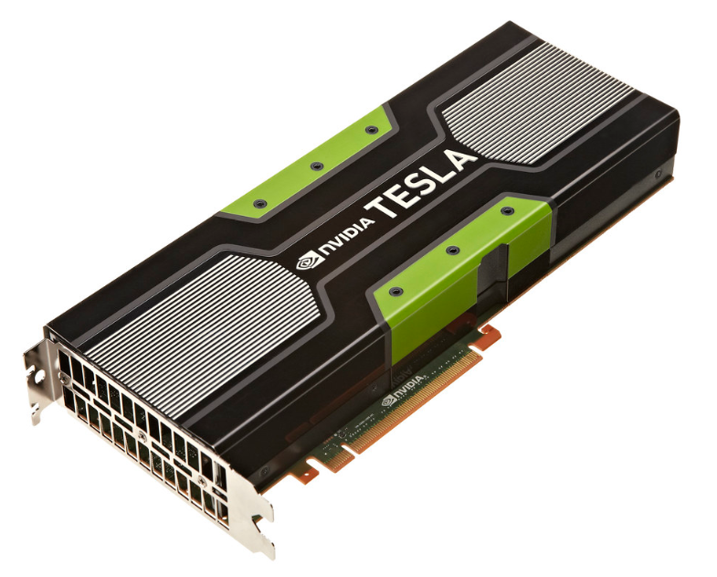

AMAZON SAGEMAKER MODEL TRAINING AND DEPLOYMENT OVERVIEW
Source: https://docs.aws.amazon.com/sagemaker/latest/dg/how-it-works-training.html
https://commons.wikimedia.org/wiki/File:Artificial_neural_network.svg
https://commons.wikimedia.org/wiki/File:AWS_Simple_Icons_Storage_Amazon_S3.svg
https://docs.aws.amazon.com/sagemaker/latest/dg/how-it-works-training.html
https://www.flickr.com/photos/gbpublic/8178512552
CLIENT
END POINT
Inference code image
MODEL DEPLYMENT/HOSTING
On ML Compute instances
S3 BUCKET
MODEL ARTIFACTS
Training code image
MODEL TRAINING
On ML Compute instances
S3 BUCKET
TRAINING BUCKET
EC2 CONTAINER REGISTERY
AMAZON SAGEMAKER

Slide 5
AMAZON SAGEMAKER COMPONENTS
Two components are present in Amazon SageMaker:
Model training
Model deployment
To start training an AI/ML model using Amazon SageMaker, you will need to create a training job with the following:
Amazon S3 bucket URL (training data): where training data is located.
Compute resources: Amazon SageMaker will train the model using instances managed by Amazon SageMaker.
Amazon S3 bucket URL (Output): this bucket will host the output from the training.
Amazon Elastic Container Registry path: where training code is stored.
Amazon SageMaker uses: (1) training code and (2) training dataset to train the model.
Amazon SageMaker saves the trained model artifacts in an S3 bucket.
Source: https://docs.aws.amazon.com/sagemaker/latest/dg/how-it-works-training.html

Slide 6
TRAINING OPTIONS OFFERED BY SAGEMAKER
USE AN ALGORITHM PROVIDED BY AMAZON SAGEMAKER
CUSTOM CODE TRAINING USING POPULAR DEEP LEARNING FRAMEWORKS
USE YOUR OWN CUSTOM ALGORITHMS
AWS MARKETPLACE
Amazon SageMaker provides ready, off the shelve training algorithms such as: Linear Learner Algorithm and the XGBoost Algorithm, K Means, Principal Component Analysis, image classification, LDA, Sequence to Sequence Algorithm.
Custom python code with TensorFlow or Apache MXNet for model training.
The code could be placed in a docker container and then registry path of the image could be provided to Amazon SageMaker CreateTrainingJob API call.
choose an algorithm from Amazon marketplace, https://aws.amazon.com/marketplace/solutions/machine-learning
USE APACHE SPARK WITH AMAZON SAGEMAKER
Apache Spark can be used to train models with Amazon SageMaker.
Source: https://docs.aws.amazon.com/sagemaker/latest/dg/how-it-works-training.html

Slide 7
AWS SAGEMAKER DEMO – PART #1 (NOTEBOOK INSTANCE)
EASY
ADVANCED

Slide 8
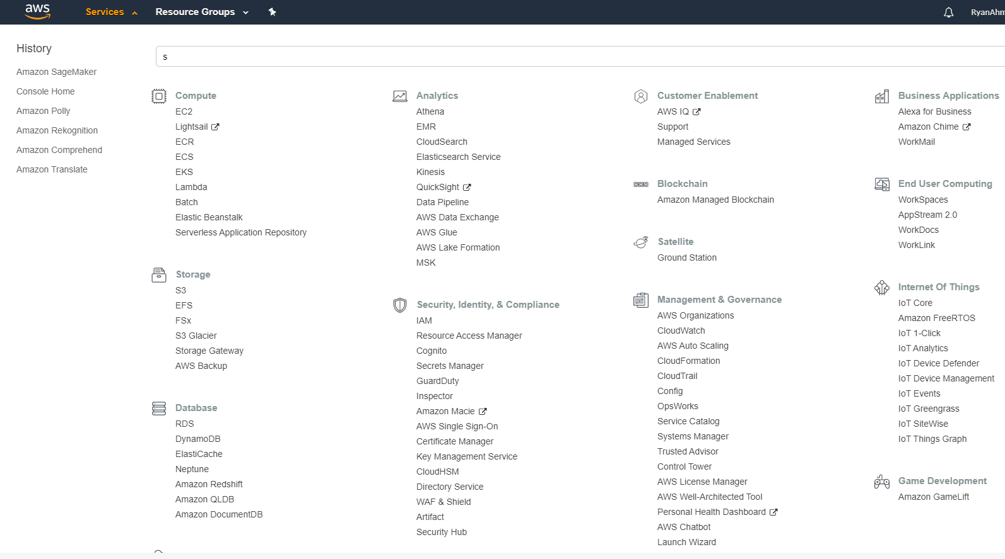
MACHINE LEARNING COMPONENTS IN AWS: 1. DATA
1. DATA
2. MODEL
3. COMPUTE
1

Slide 9
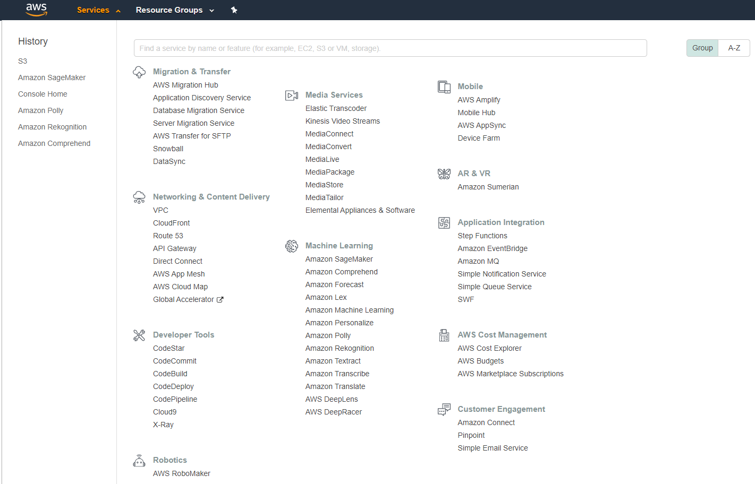
MACHINE LEARNING COMPONENTS IN AWS: 2. MODEL
1. DATA
2. MODEL
3. COMPUTE
2

Slide 10
MACHINE LEARNING COMPONENTS IN AWS: 3. COMPUTE
1. DATA
2. MODEL
3. COMPUTE
3

Slide 11
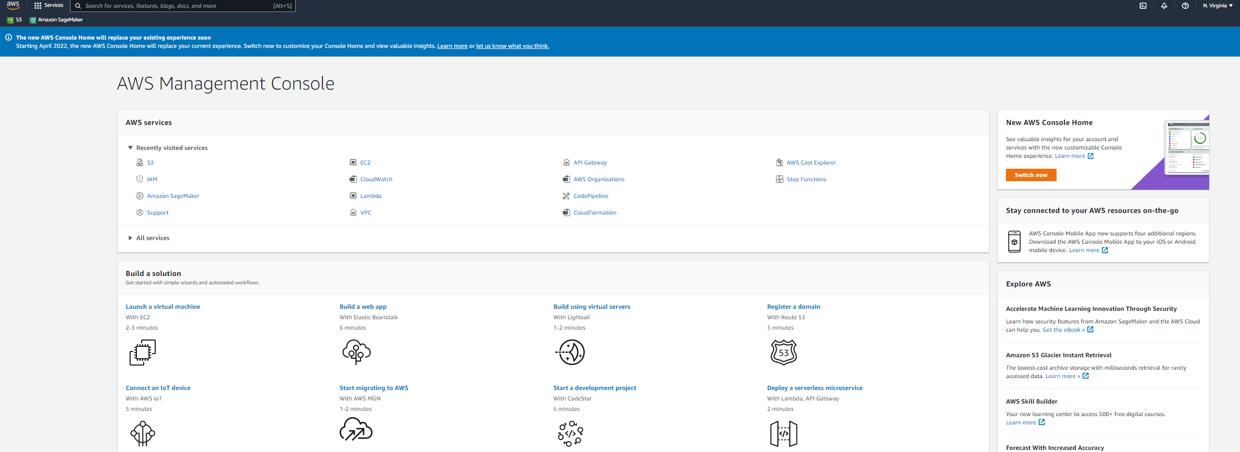
DEMO: AWS SAGEMAKER
NAVIGATE TO AWS MANAMGENT CONSOLE AND SEARCH FOR SAGEMAKER

Slide 12
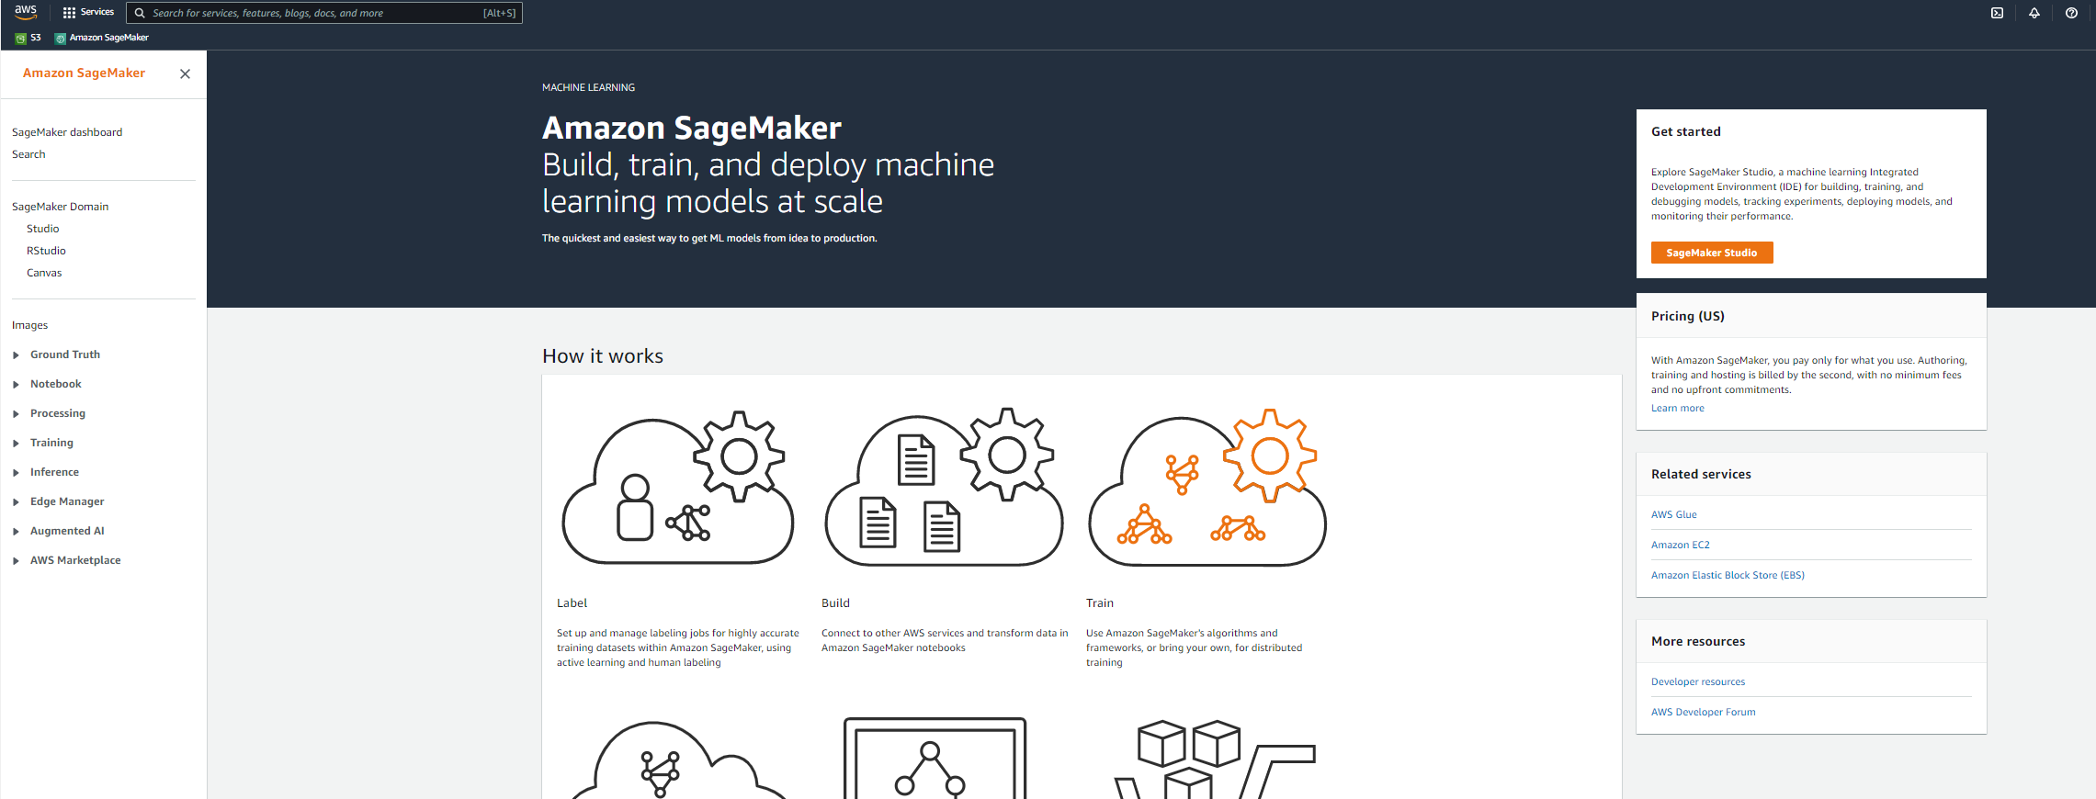
DEMO: AWS SAGEMAKER
YOU CAN LAUNCH A NOTEBOOK INSTANCE FROM THE LEFT PANEL OR YOU CAN LAUNCH SAGEMAKER STUDIO.

Slide 13
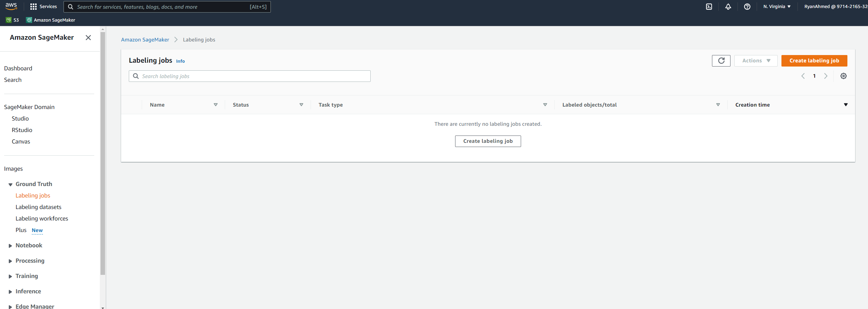
DEMO: AWS SAGEMAKER
YOU CAN CREATE A LABELING JOB BY NAVIGATING TO GROUNDTRUTH ON THE LEFT-HAND SIDE

Slide 14
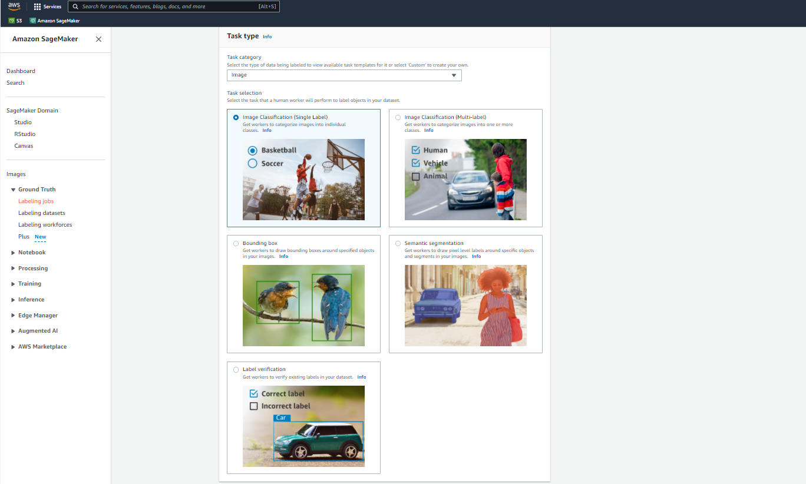
DEMO: AWS SAGEMAKER
YOU CAN CHOOSE WHAT KIND OF LABELING YOU WANT TO PERFORM. WE WILL COVER THIS IN DETAIL IN THE NEXT SECTION.

Slide 15
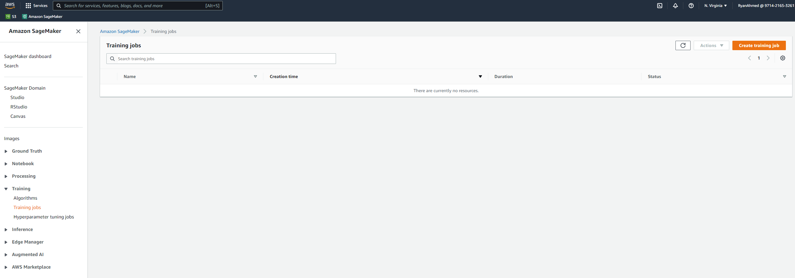
DEMO: AWS SAGEMAKER
CLICK ON TRAINING JOBS AND CLICK ON CREATE TRAINING JOB

Slide 16
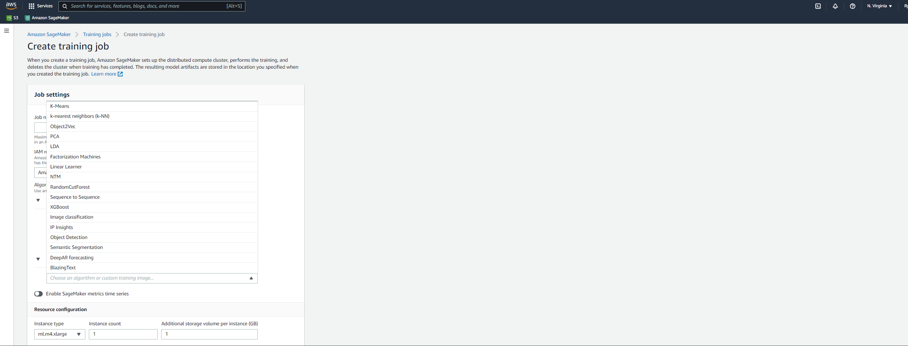
DEMO: AWS SAGEMAKER
YOU CAN CREATE A NEW TRAINING JOB AND SELECT AN ALGORITHM FROM THE LIST. NOTE THAT WE WILL COVER THIS IN GREAT DETAILS IN THE NEXT COUPLE OF DAYS!

Slide 17
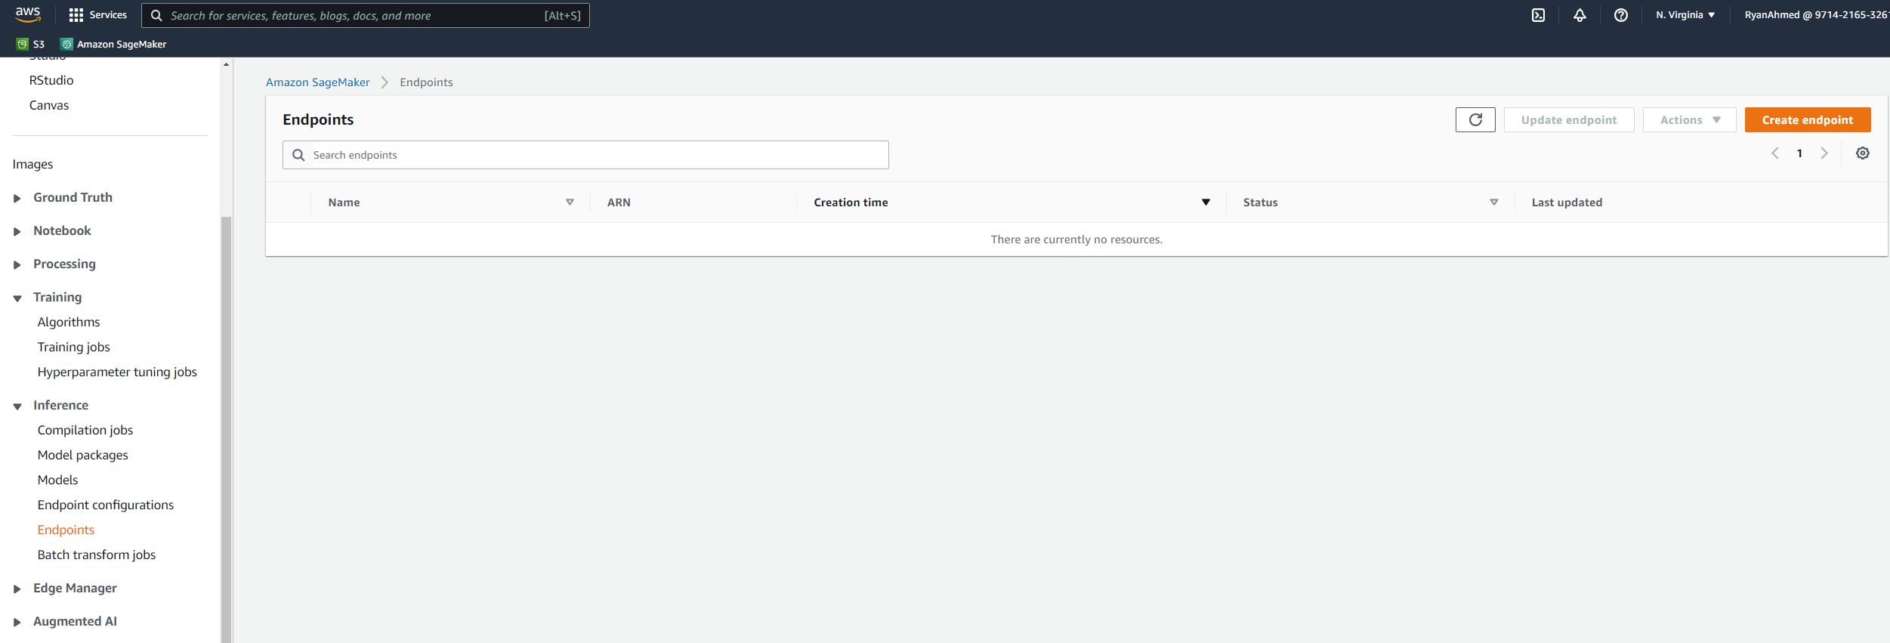
DEMO: AWS SAGEMAKER
AFTER THE MODEL IS TRAINED, YOU WILL NEED TO DEPLOY AN ENDPOINT AND MAKE INFERENCE ON THE DEPLOYED MODEL. YOU CAN CREATE AN ENDPOINT BY CLICKING ON CREATE ENDPOINT FROM THE INFERENCE PANEL.

Slide 18
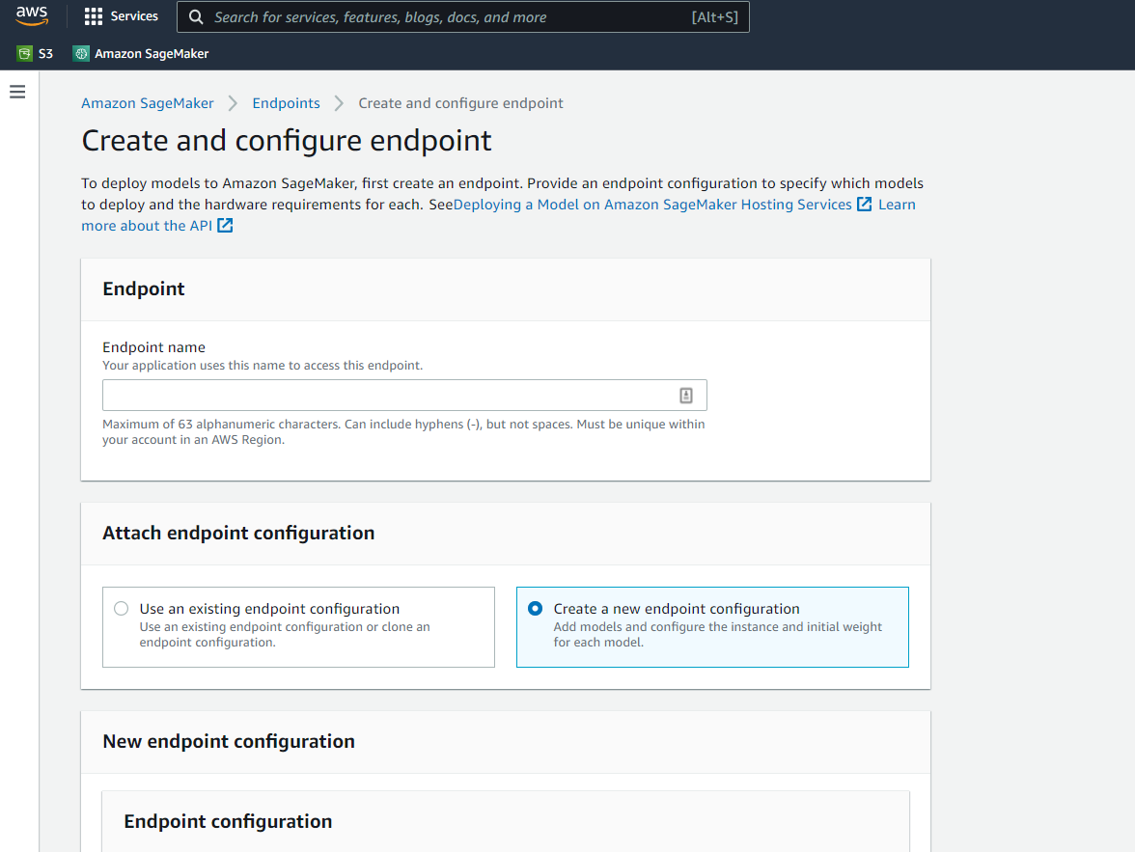
DEMO: AWS SAGEMAKER
AFTER YOU CLICK ON CREATE ENDPOINT, YOU CAN CONFIGURE THE ENDPOINT HERE!

Slide 19
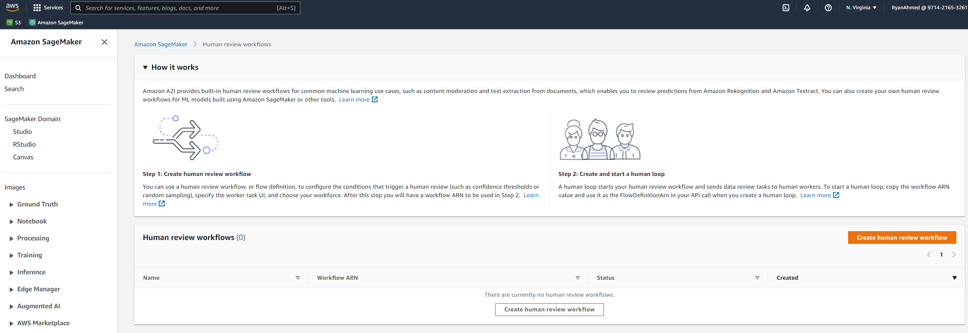
DEMO: AWS SAGEMAKER
CLICK ON AUGEMENTED AI WHICH PROVIDES BUILT-IN HUMAN REVIEWS FOR ML WORKFLOWS.

Slide 20
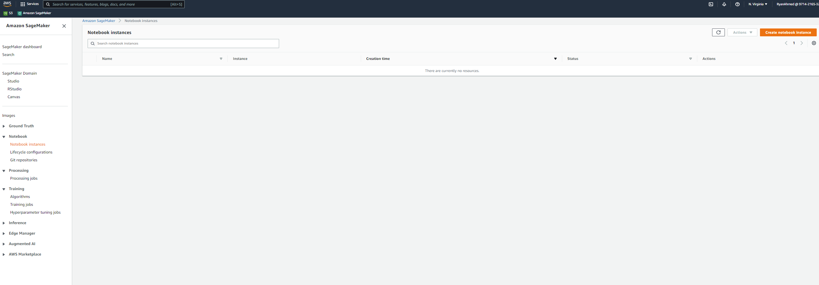
DEMO: AWS SAGEMAKER
CLICK ON NOTEBOOK INSTANCES AND CLICK ON CREATE NOTEBOOK INSTANCE

Slide 21
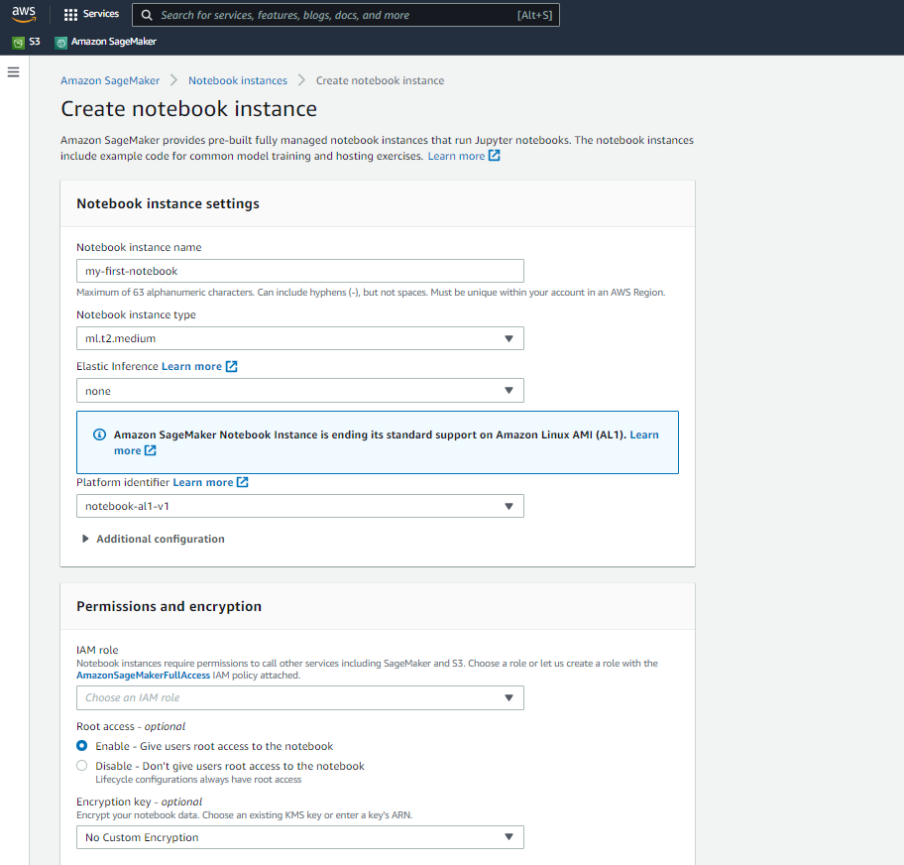
DEMO: AWS SAGEMAKER
PROVIDE A NAME AND SELECT INSTANCE TYPE. NOTE THAT YOU CAN ENABLE ELASTIC INFERENCE. ELASTIC INFERENCE (EI) CAN SPEED UP THE THROUGHPUT AND DECREASE THE LATENCY AT A FRACTION OF THE COST OF USING A DEDICATED GPU INSTANCE.

Slide 22
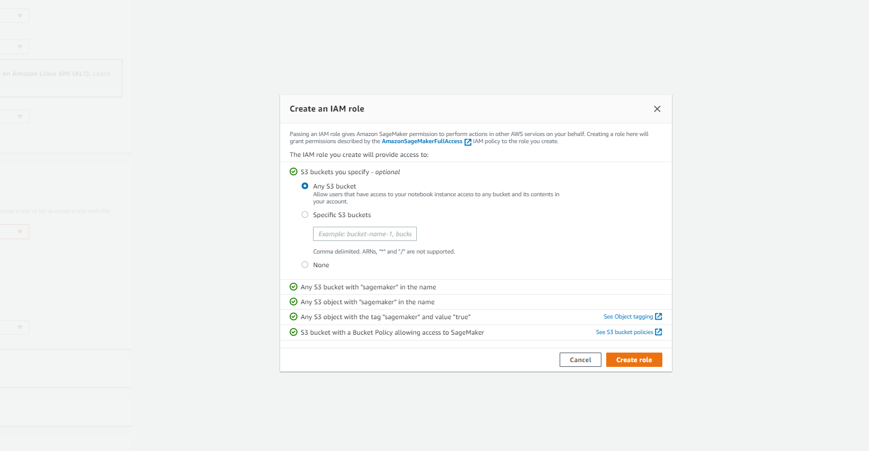
DEMO: AWS SAGEMAKER
CREATE A NEW IAM ROLE THAT CAN ACCESS ANY S3 BUCKET. CLICK ON CREATE ROLE.

Slide 23
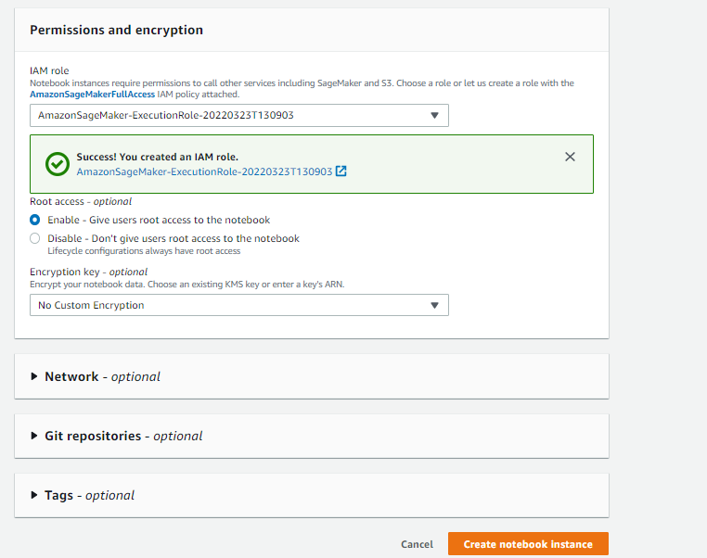
DEMO: AWS SAGEMAKER
NOW THE ROLE IS CREATED! CLICK ON CREATE NOTEBOOK INSTANCE.

Slide 24
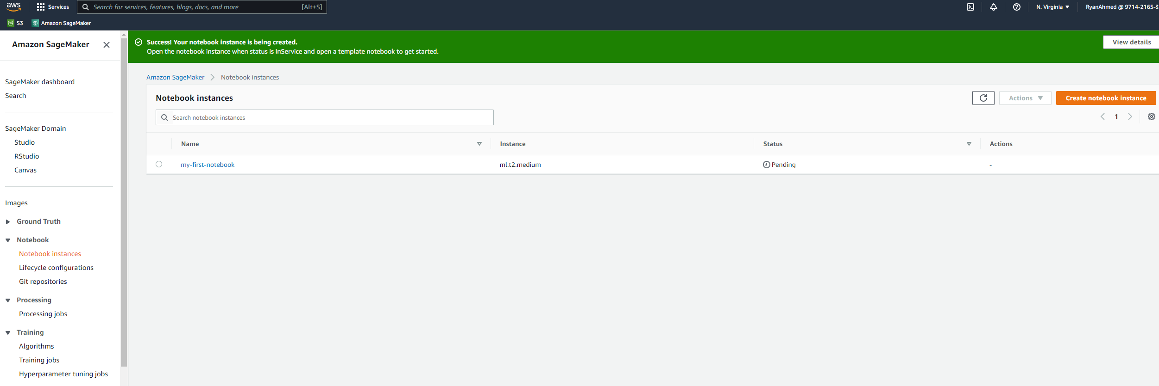
DEMO: AWS SAGEMAKER
THE NOTEBOOK INSTANCE IS NOW BEING CREATED. NOTE THAT YOU MUST TERMINATE THE INSTANCE TO AVOID INCURRING ANY CHARGES IN THE FUTURE.

Slide 25
AWS SAGEMAKER DEMO – PART #2 (WRITE YOUR FIRST CODE & TERMINATE INSTANCE)
EASY
ADVANCED

Slide 26

DEMO: AWS SAGEMAKER
NOW THE INSTANCE SHOWS IN-SERVICE, CLICK ON OPEN JUPYTER

Slide 27
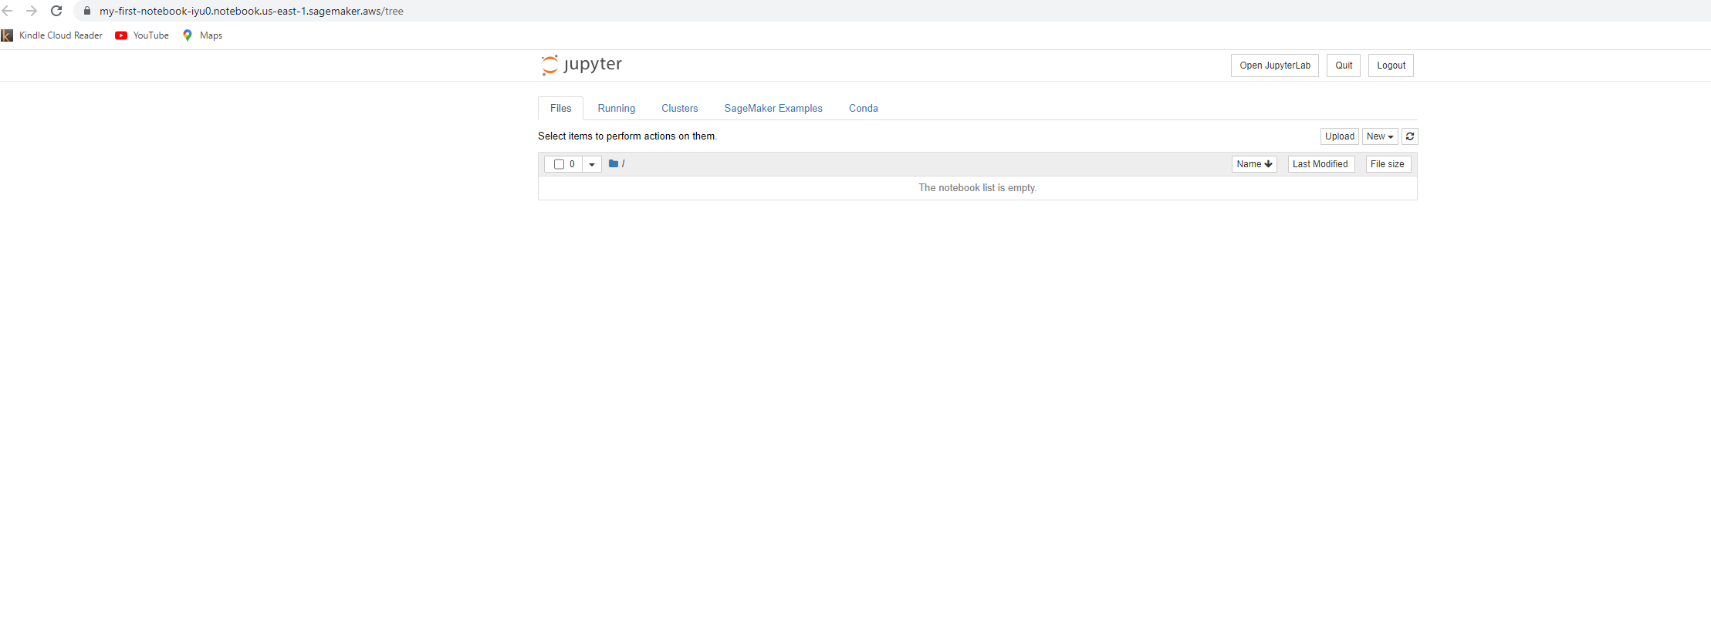
DEMO: AWS SAGEMAKER
NOW YOU CAN CLICK ON NEW TO CREATE A NEW NOTEBOOK

Slide 28
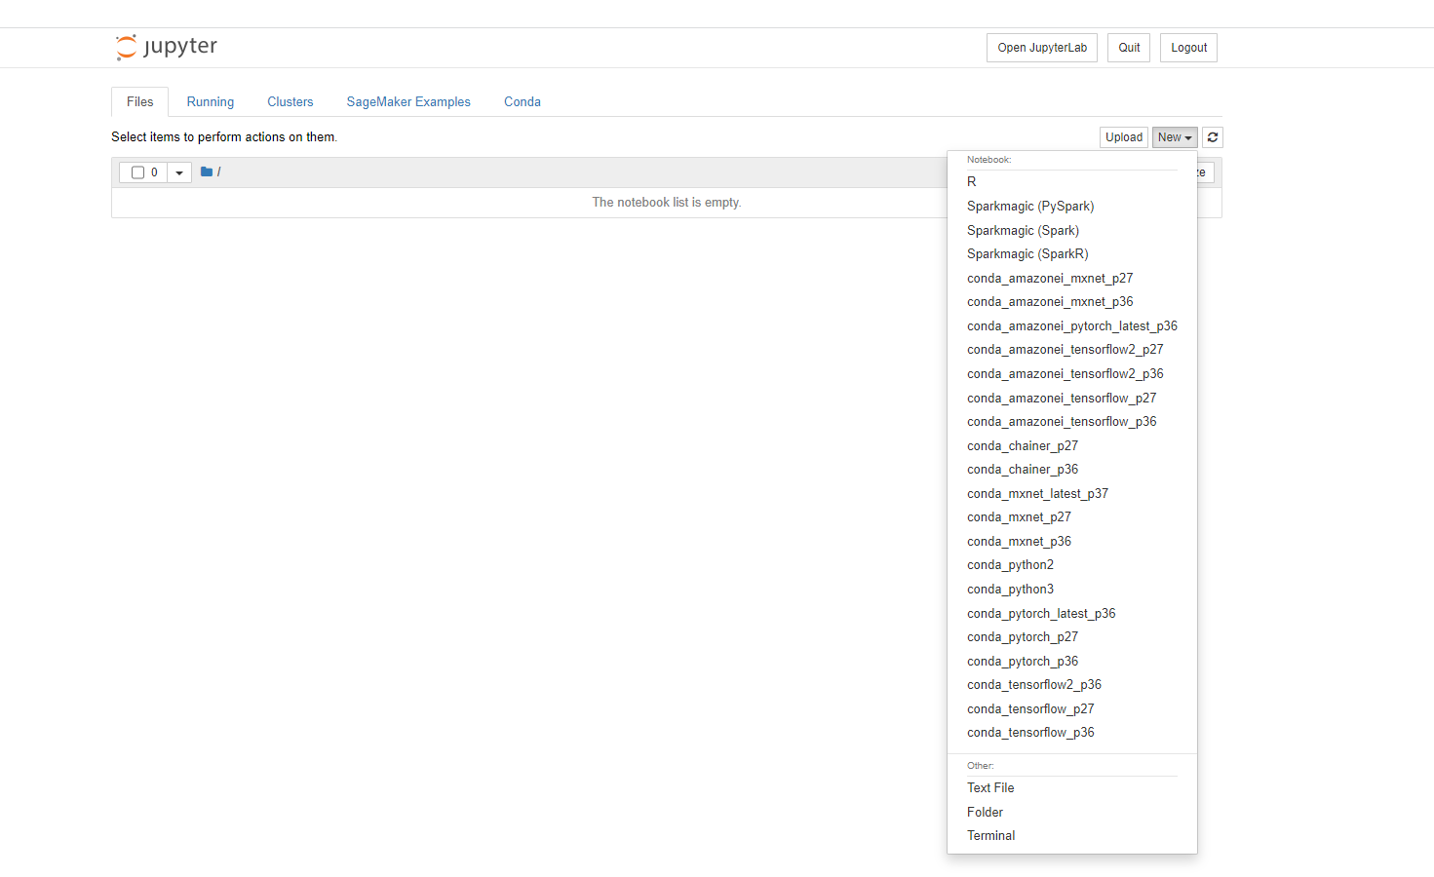
DEMO: AWS SAGEMAKER
SELECT CONDA_PYTHON3

Slide 29
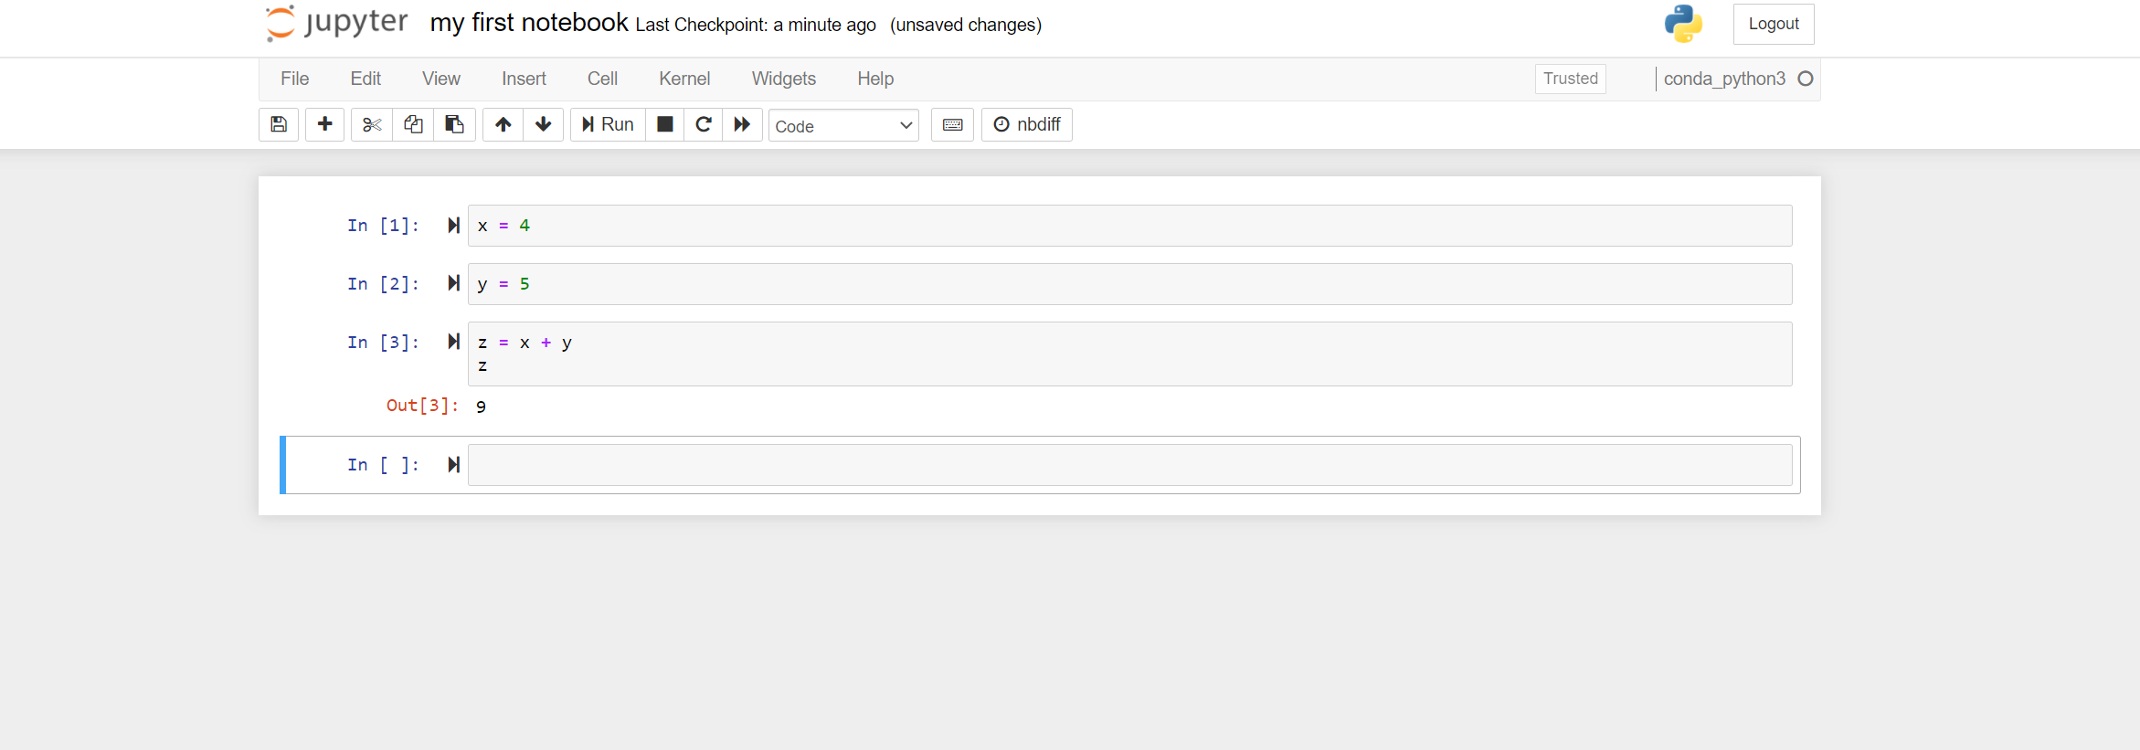
DEMO: AWS SAGEMAKER
WRITE YOUR FIRST CODE

Slide 30
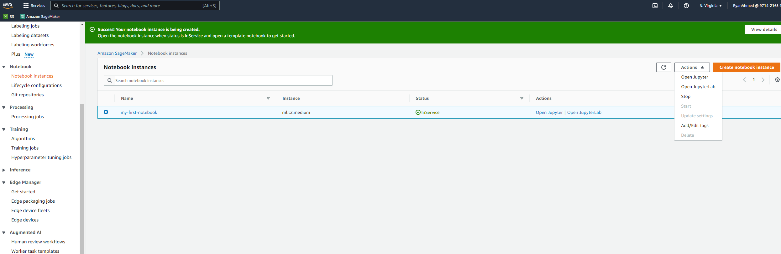
DEMO: AWS SAGEMAKER
TERMINATE THE INSTANCE BY SELECTING ACTIONS THEN STOP [IMPORTANT]

Slide 31
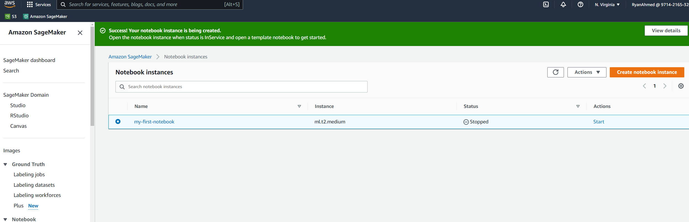
DEMO: AWS SAGEMAKER
NOW IT SHOWS STOPPED. YOU THEN CLICK ON ACTIONS AND DELETE THE INSTANCE.

Slide 32
AWS SAGEMAKER DEMO – PART #3 (MARKETPLACE TUTORIAL)
EASY
ADVANCED

Slide 33
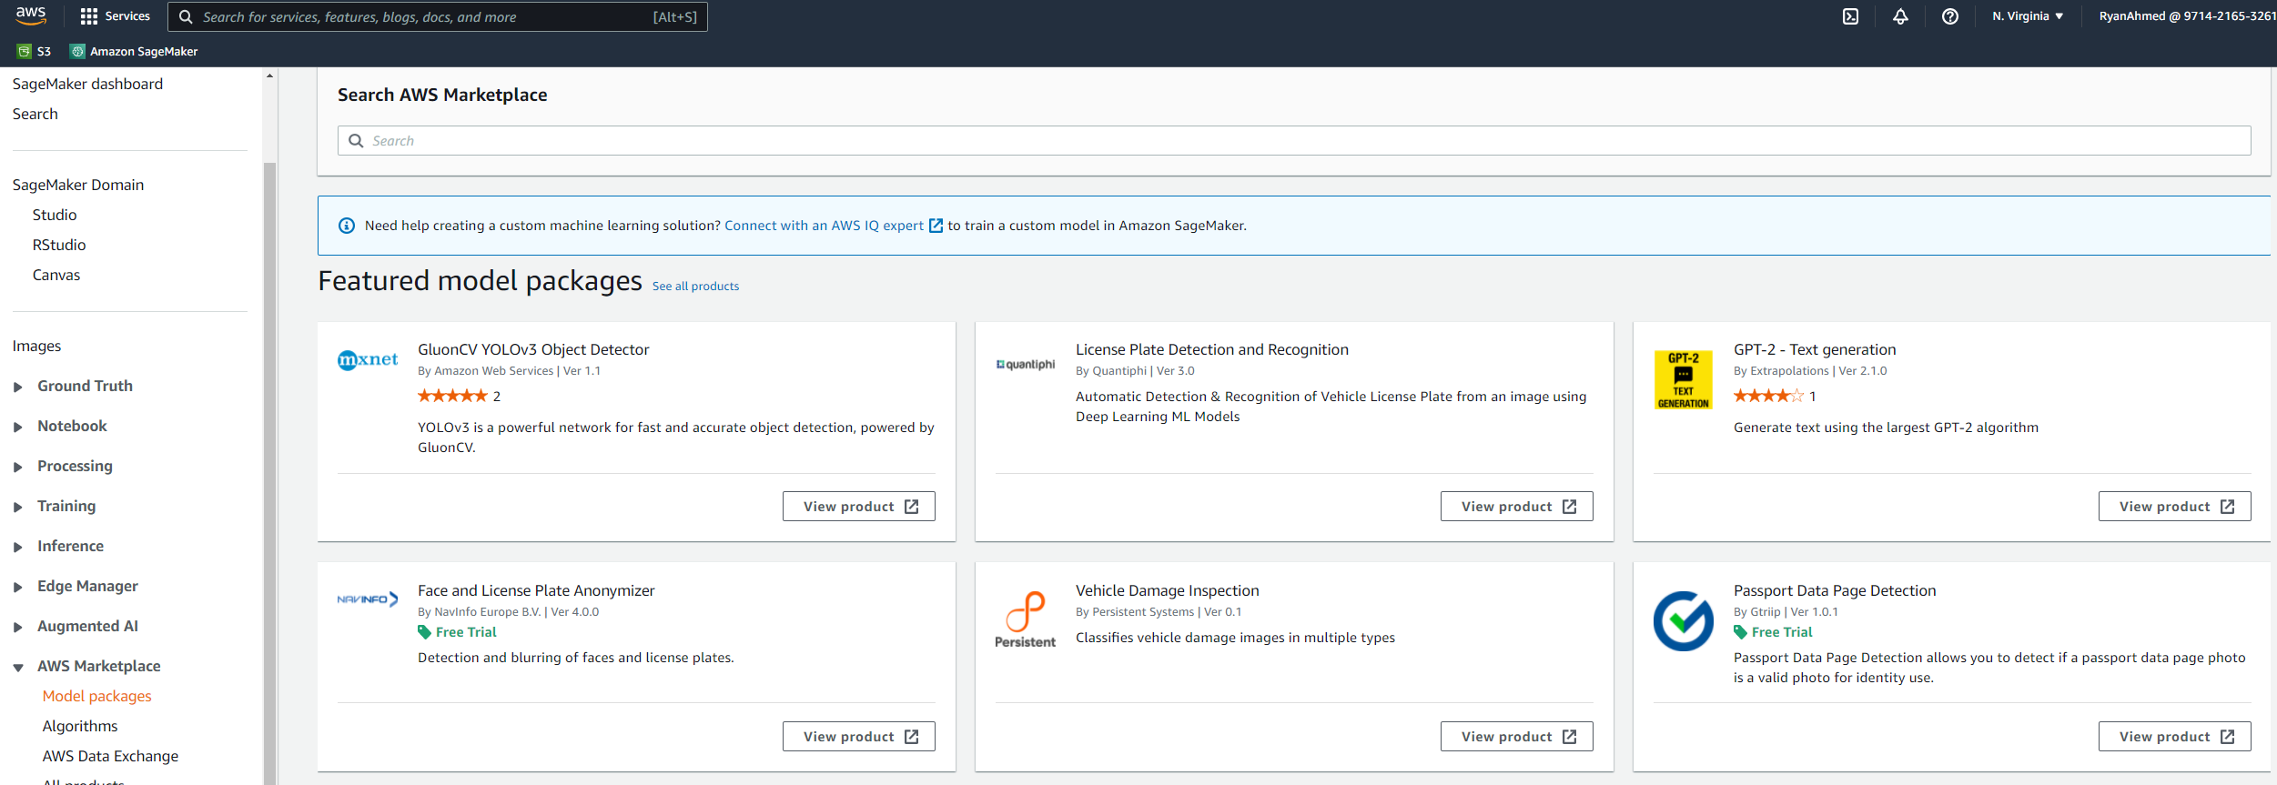
DEMO: AWS SAGEMAKER
NAVIGATE TO AWS MARKETPLACE AND SELECT MODEL PACKAGES. THESE ARE PRETRAINED MODELS THAT ARE READY TO USE!

Slide 34
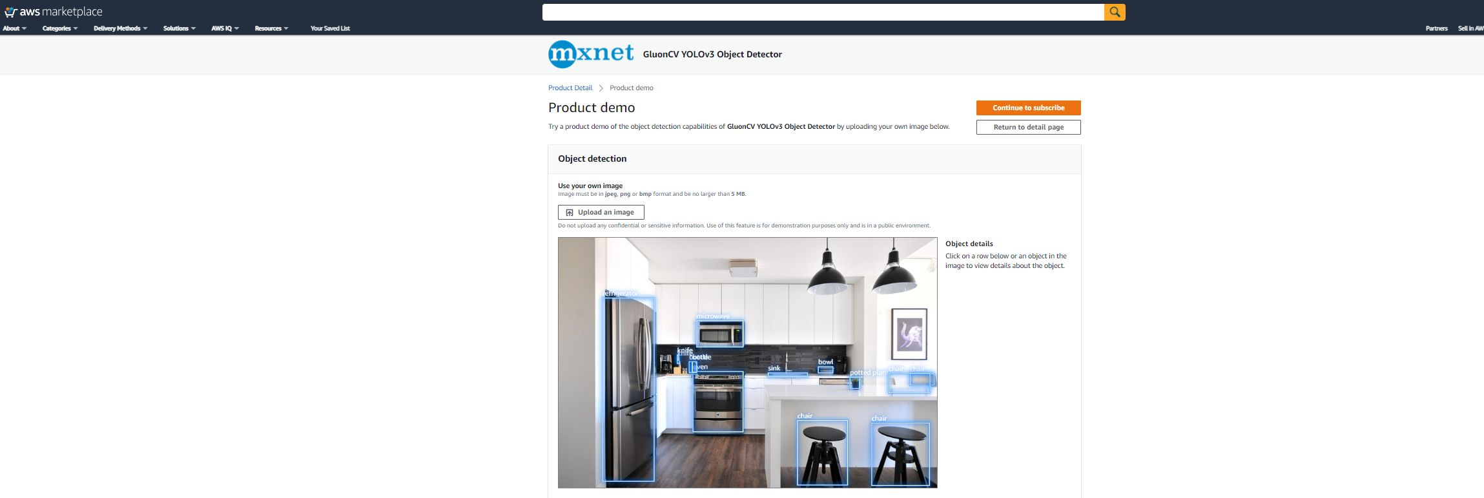
DEMO: AWS SAGEMAKER
LET’S TRY A SAMPLE MODEL FROM THE AWS MARKETPLACE

Slide 35
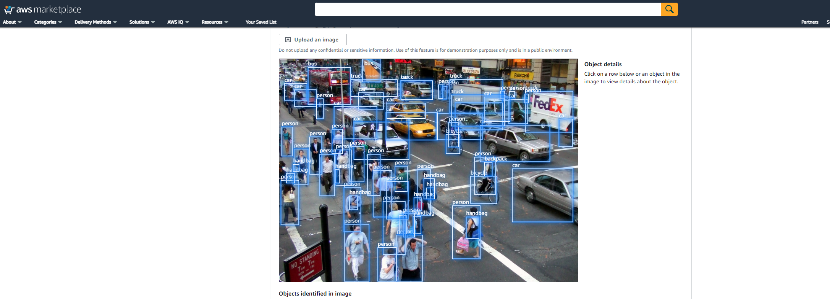
DEMO: AWS SAGEMAKER
LET’S TRY A SAMPLE MODEL FROM THE AWS MARKETPLACE

Slide 36
AWS SAGEMAKER DEMO – PART #4 (SAGEMAKER STUDIO)
EASY
ADVANCED

Slide 37
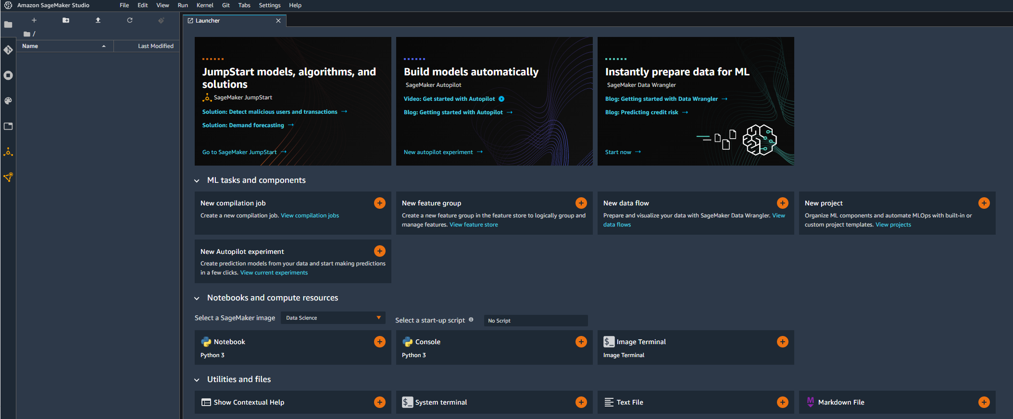
DEMO: AWS SAGEMAKER
Amazon SageMaker Studio is a web-based visual interface where developers can build, train and deploy AI/ML models in one place!
SageMaker Studio enhances productivity by 10x since it offers much higher visibility and control compared to regular notebook instances.
Developers can manage experiments, debug ML models, monitor models for bias and drift in SageMaker Studio.

Slide 38
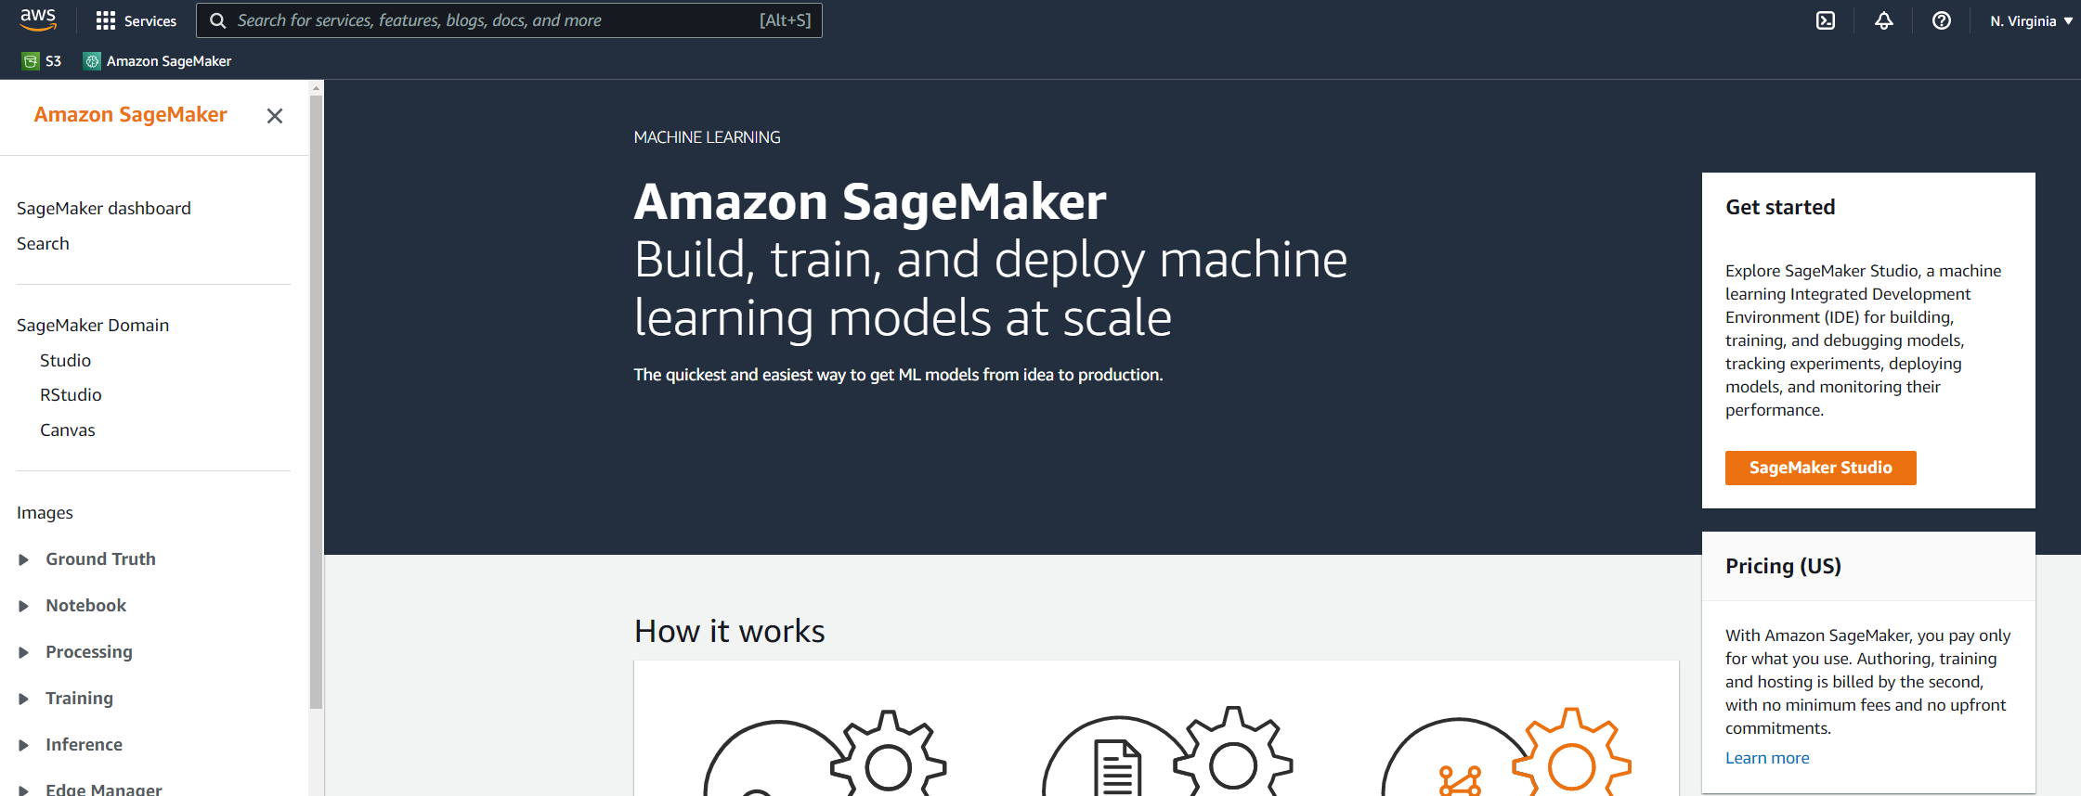
DEMO: AWS SAGEMAKER
CLICK ON SAGEMAKER STUDIO

Slide 39
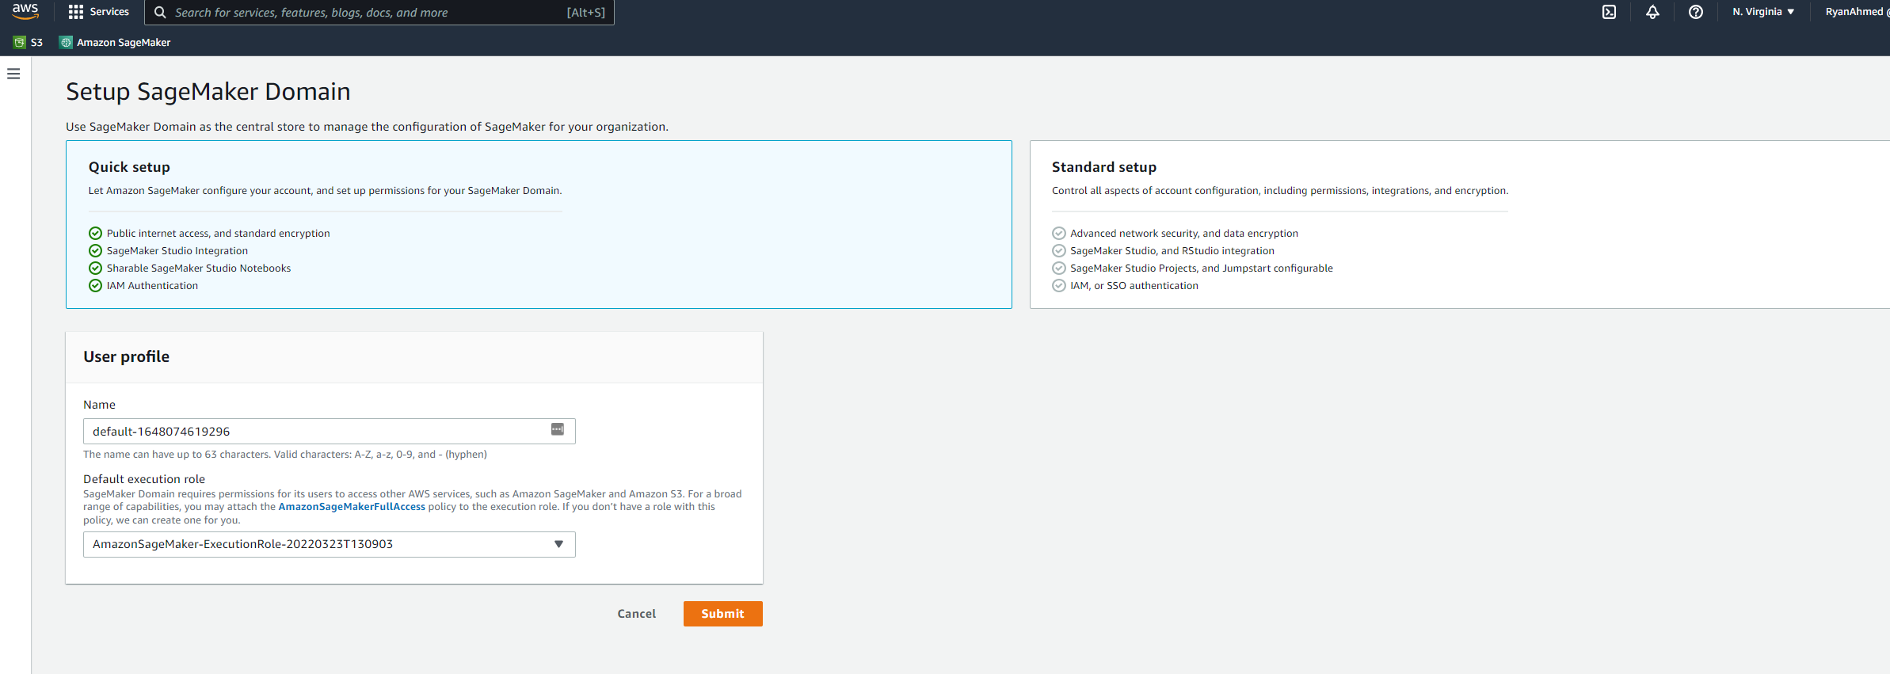
DEMO: AWS SAGEMAKER
YOU WILL NEED TO SETUP A SAGEMAKER DOMAIN. KEEP EVERYTHING AS DEFAULT AND CLICK SUBMIT.

Slide 40
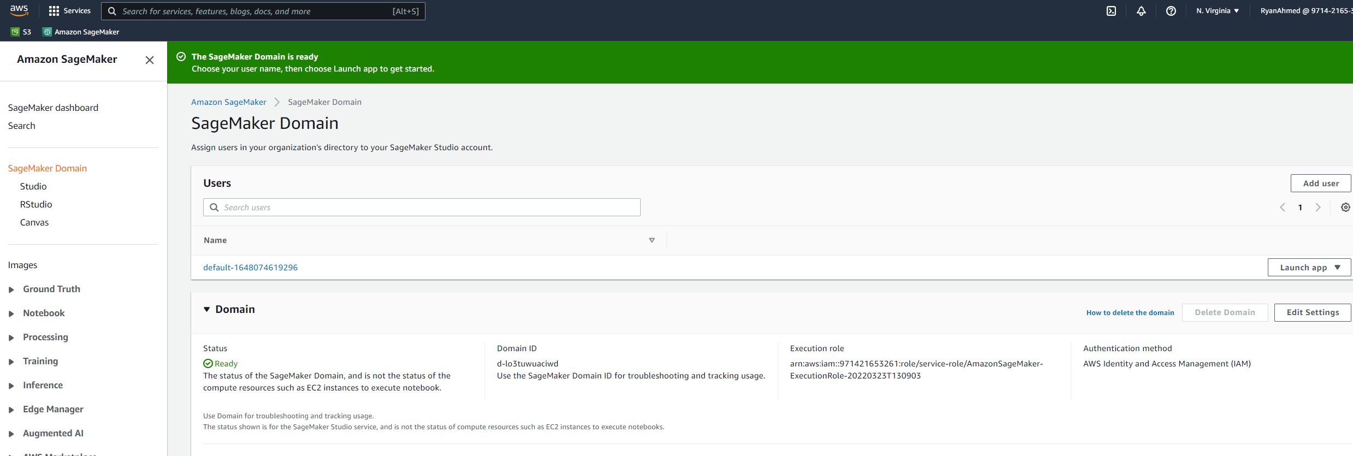
DEMO: AWS SAGEMAKER
SAGEMAKER DOMAIN IS NOW CREATED AND READY. CLICK ON LAUNCH APP AND THEN STUDIO.

Slide 41

DEMO: AWS SAGEMAKER
YOU SHOULD SEE THE SAGEMAKER STUDIO JUPYTER SERVER STARTING UP

Slide 42
DEMO: AWS SAGEMAKER
WELCOME TO SAGEMAKER STUDIO

Slide 43
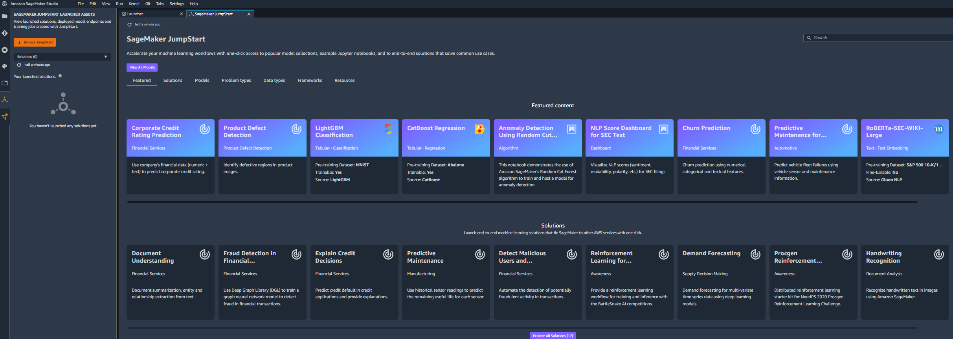
DEMO: AWS SAGEMAKER
CLICK ON JUMSTART

Slide 44
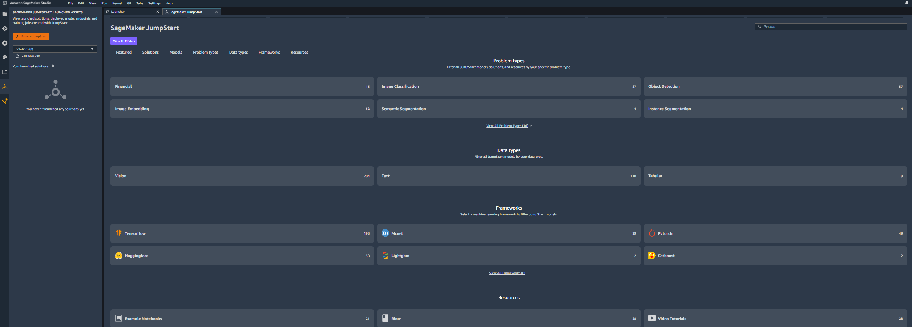
DEMO: AWS SAGEMAKER
YOU WILL FIND MANY MODELS GROUPED BASED ON DATA TYPES, PROBLEM TYPES, AND FRAMEWORKS

Slide 45
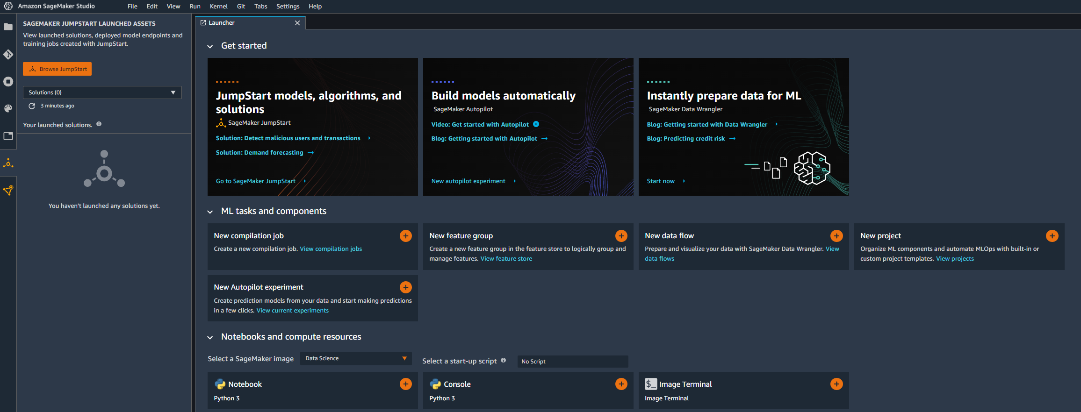
DEMO: AWS SAGEMAKER
CLICK ON NOTEBOOK TO LAUNCH A JUPYTER NOTEBOOK

Slide 46
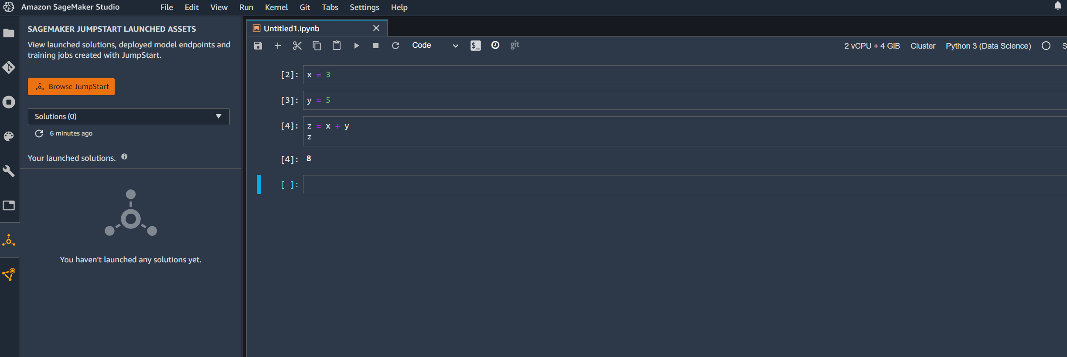
DEMO: AWS SAGEMAKER
RUN YOUR FIRST CODE IN SAGEMAKER STUDIO

Slide 47
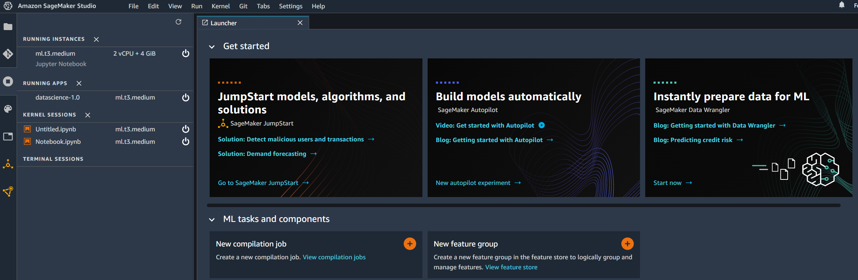
DEMO: AWS SAGEMAKER
TERMINATATION OF SAGEMAKER STUDIO IS DIFFERENT COMPARED TO A REGULAR SAGEMAKER INSTANCE. YOU WILL NEED TO CLIK ON POWER OFF BUTTON [IMPORTANT].

Slide 48
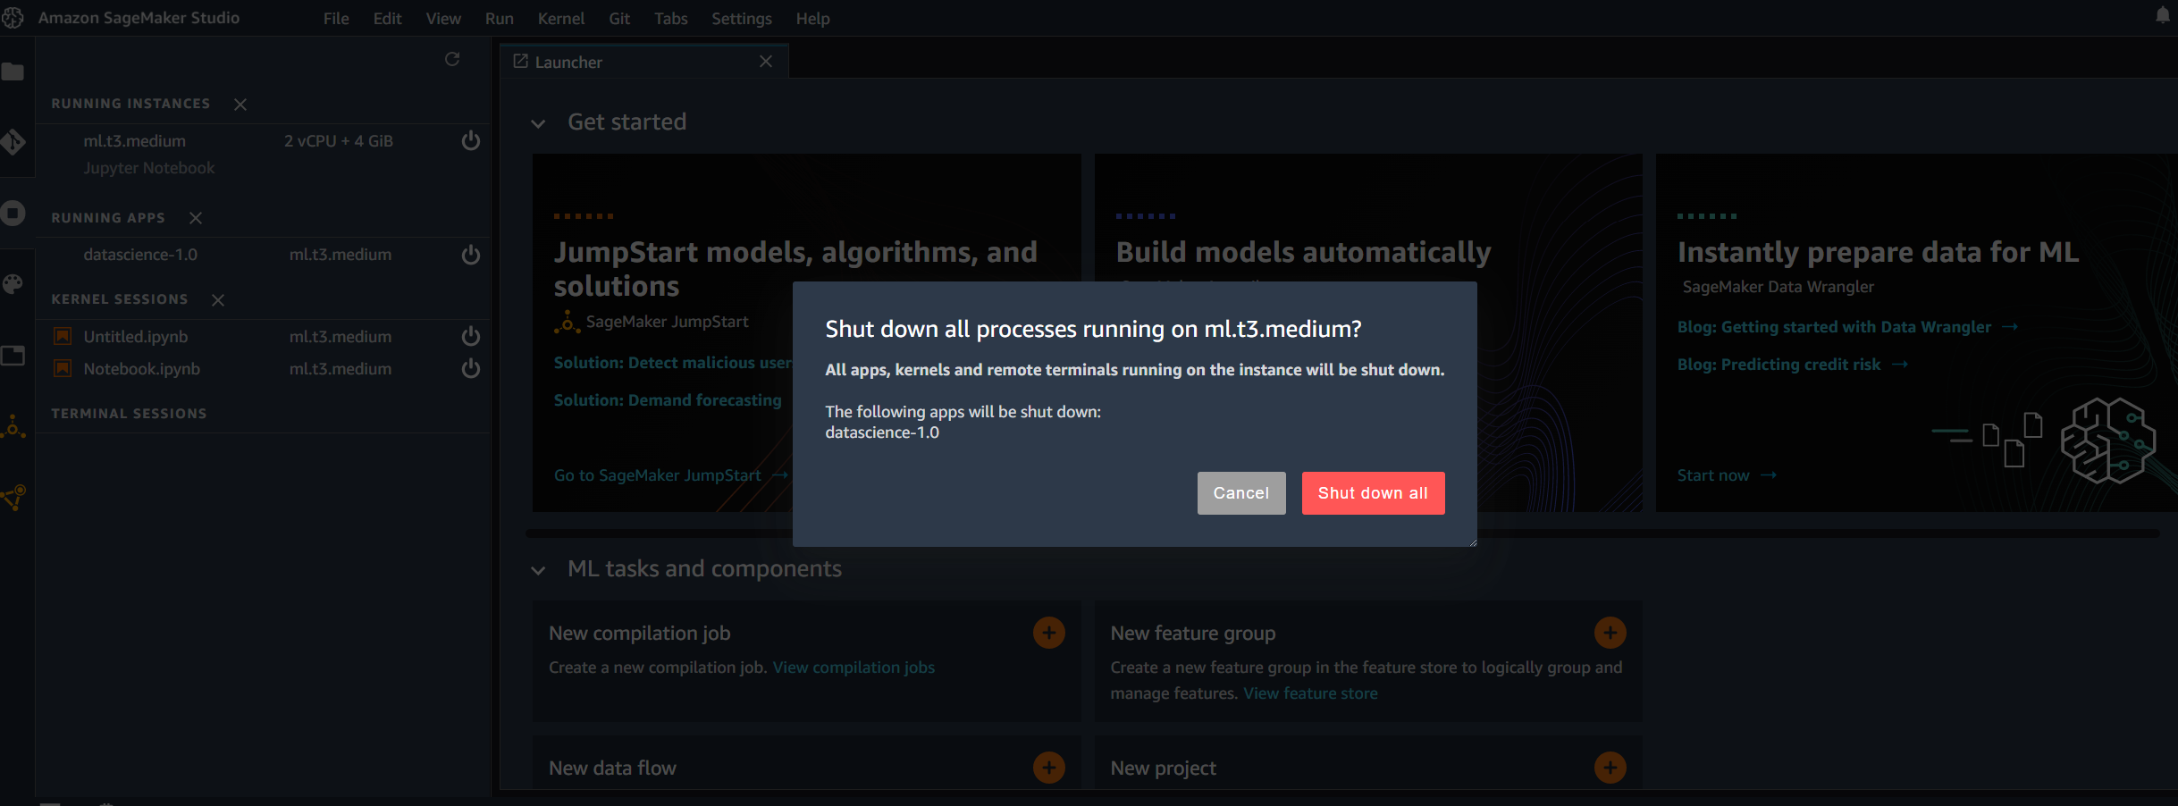
DEMO: AWS SAGEMAKER
CLICK ON SHUTDOWN ALL

Slide 49
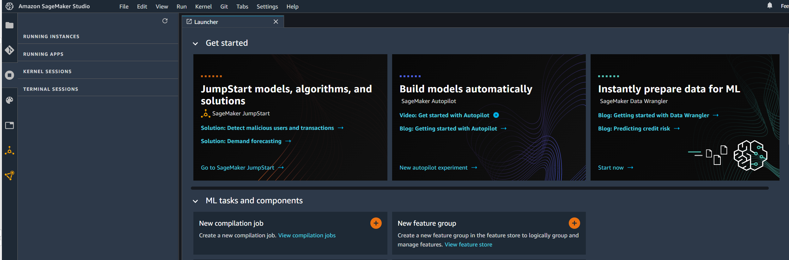
DEMO: AWS SAGEMAKER
NOW YOU’RE GOOD TO GO! NO ADDITIONAL CHARGES WILL BE INCURRED!

Slide 50
AWS SAGEMAKER DEMO – PART #5 (SAGEMAKER CANVAS OVERVIEW)
EASY
ADVANCED

Slide 51
WHAT IS AWS SAGEMAKER CANVAS?
AWS SageMaker Canvas empowers anyone to build, train and test a machine learning model without writing a single line of code!
With AWS Canvas, anyone can:
Import data from S3 or any other source
Build an AI/ML model
Assess model performance
Perform inference and generate predictions
Export model to SageMaker Studio
AWS SageMaker Canvas Documentation:
https://aws.amazon.com/sagemaker/canvas/

Slide 52
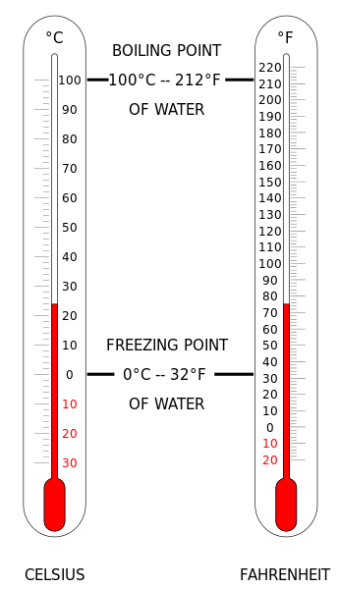
PROJECT OVERVIEW: CONVERT °C TO °F
In this project, we will train a simple machine learning model to convert temperatures from Celsius to Fahrenheit using Amazon SageMaker Canvas.
SageMaker Canvas allows anyone to build powerful ML models without writing any code or having any prior knowledge with AI/ML.
The equation is as follows:
T(°F) = T(°C) × 9/5 + 32
For Example, let's convert 0°C Celsius temperature to Fahrenheit:
T(°F) = (0°C × 9/5) + 32 = 32°F
Image Source: https://commons.wikimedia.org/wiki/File:Thermometer_CF.svg

Slide 53
PROJECT OVERVIEW: CONVERT °C TO °F
The objective is to predict the value of one variable Y based on another variable X.
X is called the independent variable and Y is called the dependant variable.
This is called “Regression” and it will be covered in much more detail in later sections of the course.
TEMPERATURE IN FAHRENHEIT (°F)
TEMPERATURE IN CELSIUS (°C)

Slide 54
AWS SAGEMAKER DEMO – PART #6 (SAGEMAKER CANVAS DATA UPLOAD)
EASY
ADVANCED

Slide 55
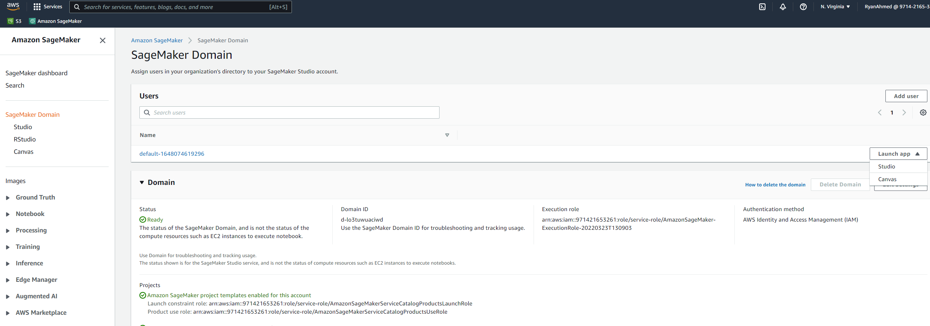
DEMO: AWS SAGEMAKER
OPEN SAGEMAKER AND CLICK ON LAUNCH APP AND THEN CANVAS

Slide 56
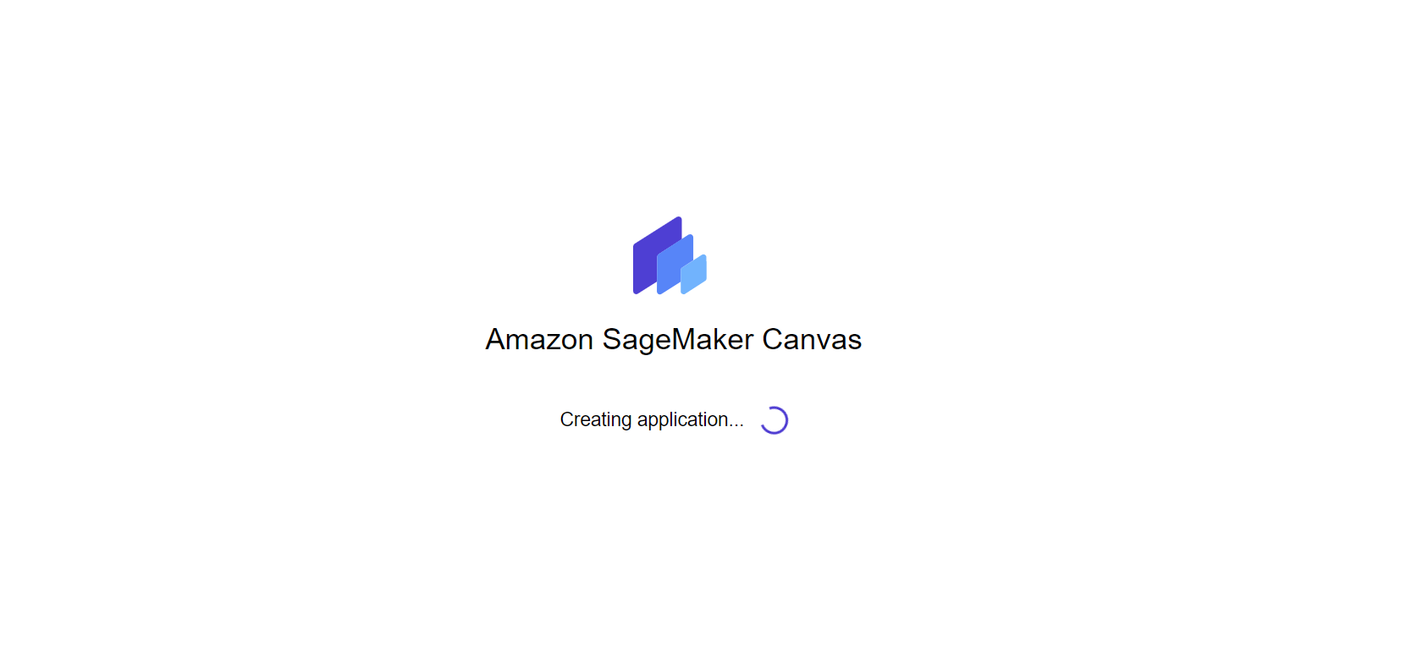
DEMO: AWS SAGEMAKER
IT MIGHT TAKE COUPLE OF MINUTES FOR SAGEMAKER CANVAS TO START. BE PATIENT IT’S WORTH IT!

Slide 57
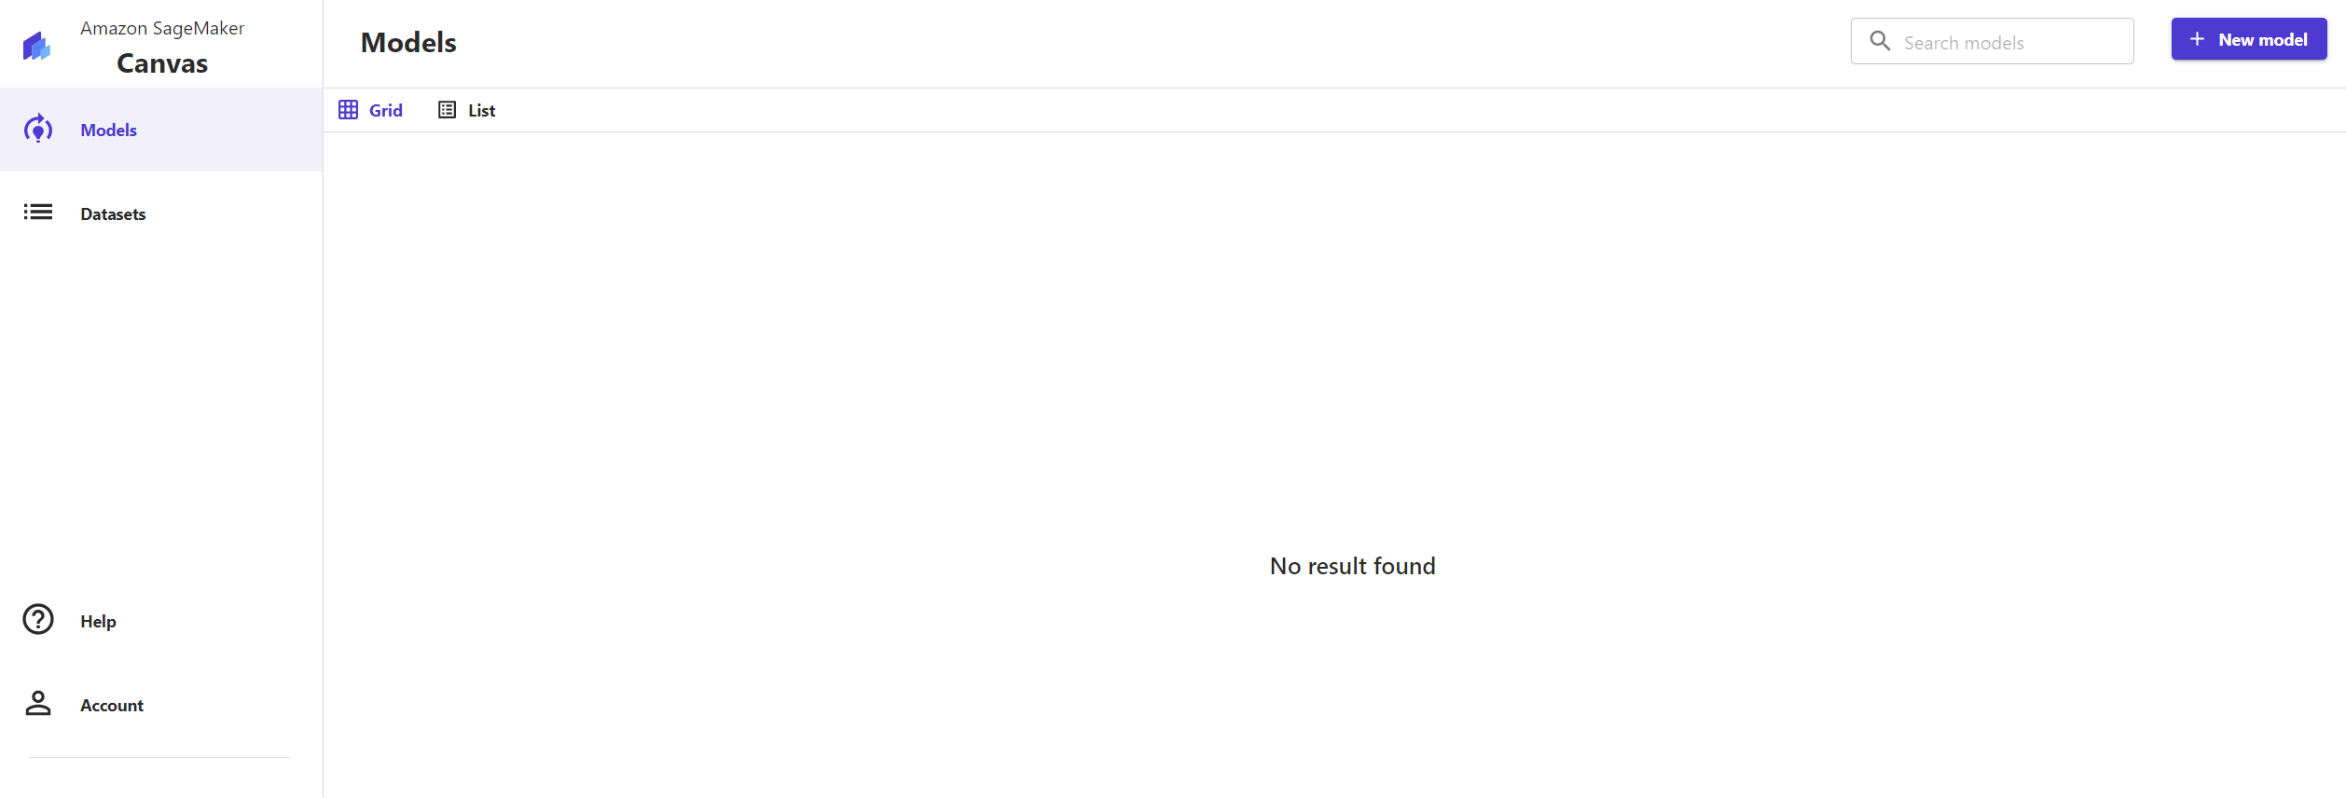
DEMO: AWS SAGEMAKER
HERE’S AMAZON SAGEMAKER CANVAS HOMEPAGE! LET’S UPLOAD THE DATA INTO S3 FIRST.

Slide 58
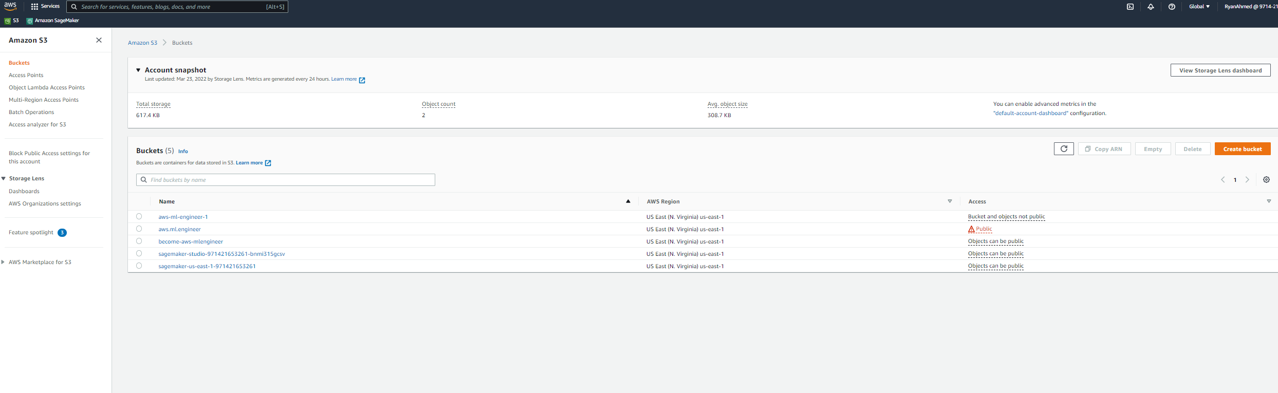
DEMO: AWS SAGEMAKER
GO TO S3 AND CLICK ON CREATE BUCKET

Slide 59
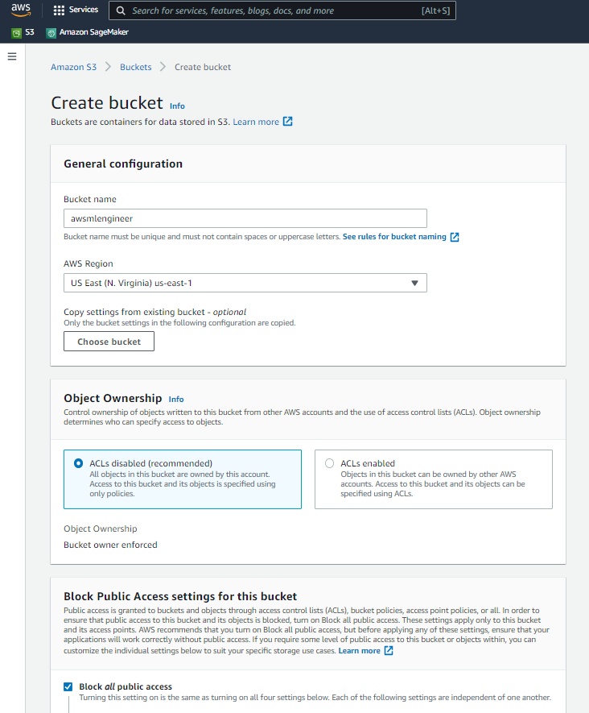
DEMO: AWS SAGEMAKER
PROVIDE A NAME TO THE BUCKET AND CLICK ON CREATE BUCKET

Slide 60
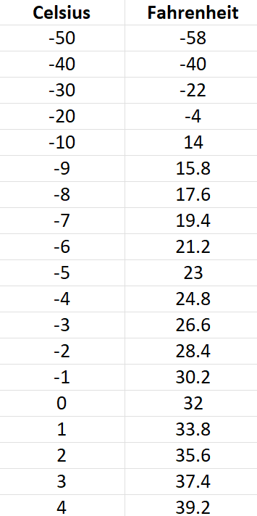
DEMO: AWS SAGEMAKER
LET’S UPLOAD THIS DATA TO S3. THE FILE “CELCIUS TO FAHRENHEIT.CSV” IS INCLUDED IN THE COUTSE PACKAGE

Slide 61
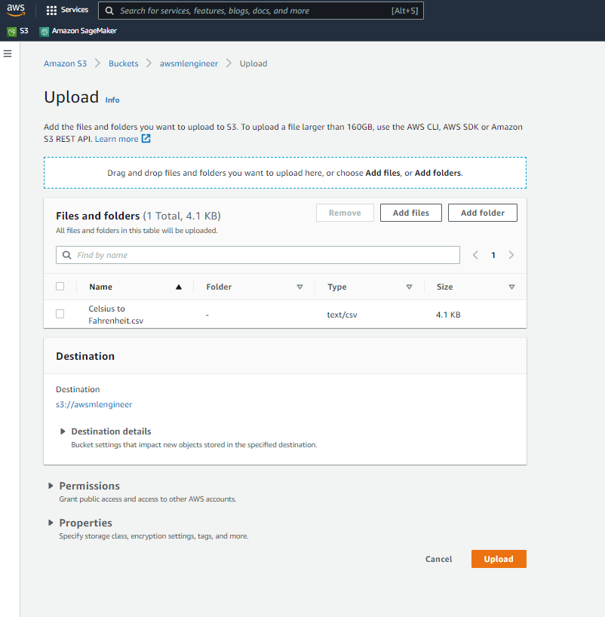
DEMO: AWS SAGEMAKER
DRAG AND DROP THE FILE AND CLICK UPLOAD

Slide 62
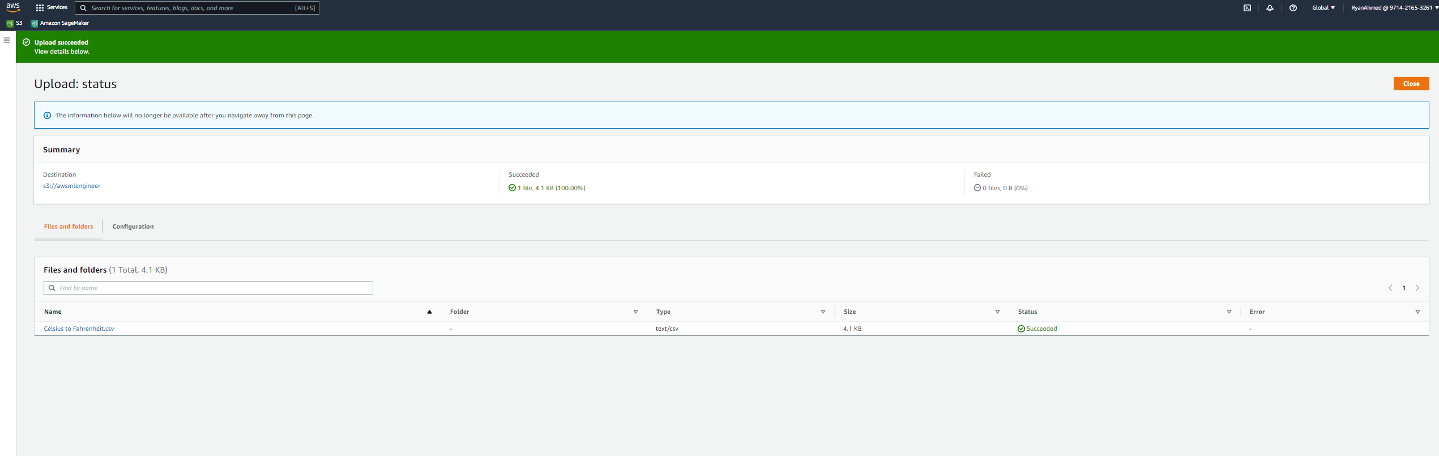
DEMO: AWS SAGEMAKER
NOW THE DATA IS UPLOADED TO S3. YOU SHOULD BE ABLE TO SEE IT IN CANVAS NOW.

Slide 63
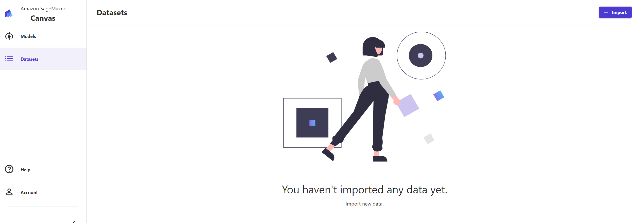
DEMO: AWS SAGEMAKER
CLICK ON IMPORT

Slide 64
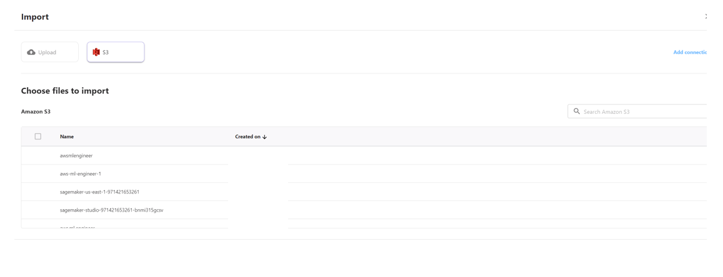
DEMO: AWS SAGEMAKER
SELECT THE BUCKET

Slide 65
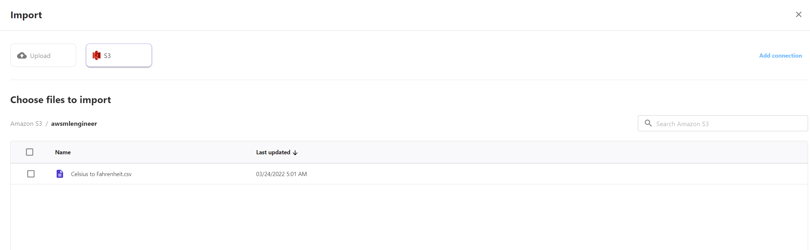
DEMO: AWS SAGEMAKER
SELECT THE FILE AND CLICK IMPORT

Slide 66
AWS SAGEMAKER DEMO – PART #7 (SAGEMAKER CANVAS MODEL TRAINING/EVAL)
EASY
ADVANCED

Slide 67
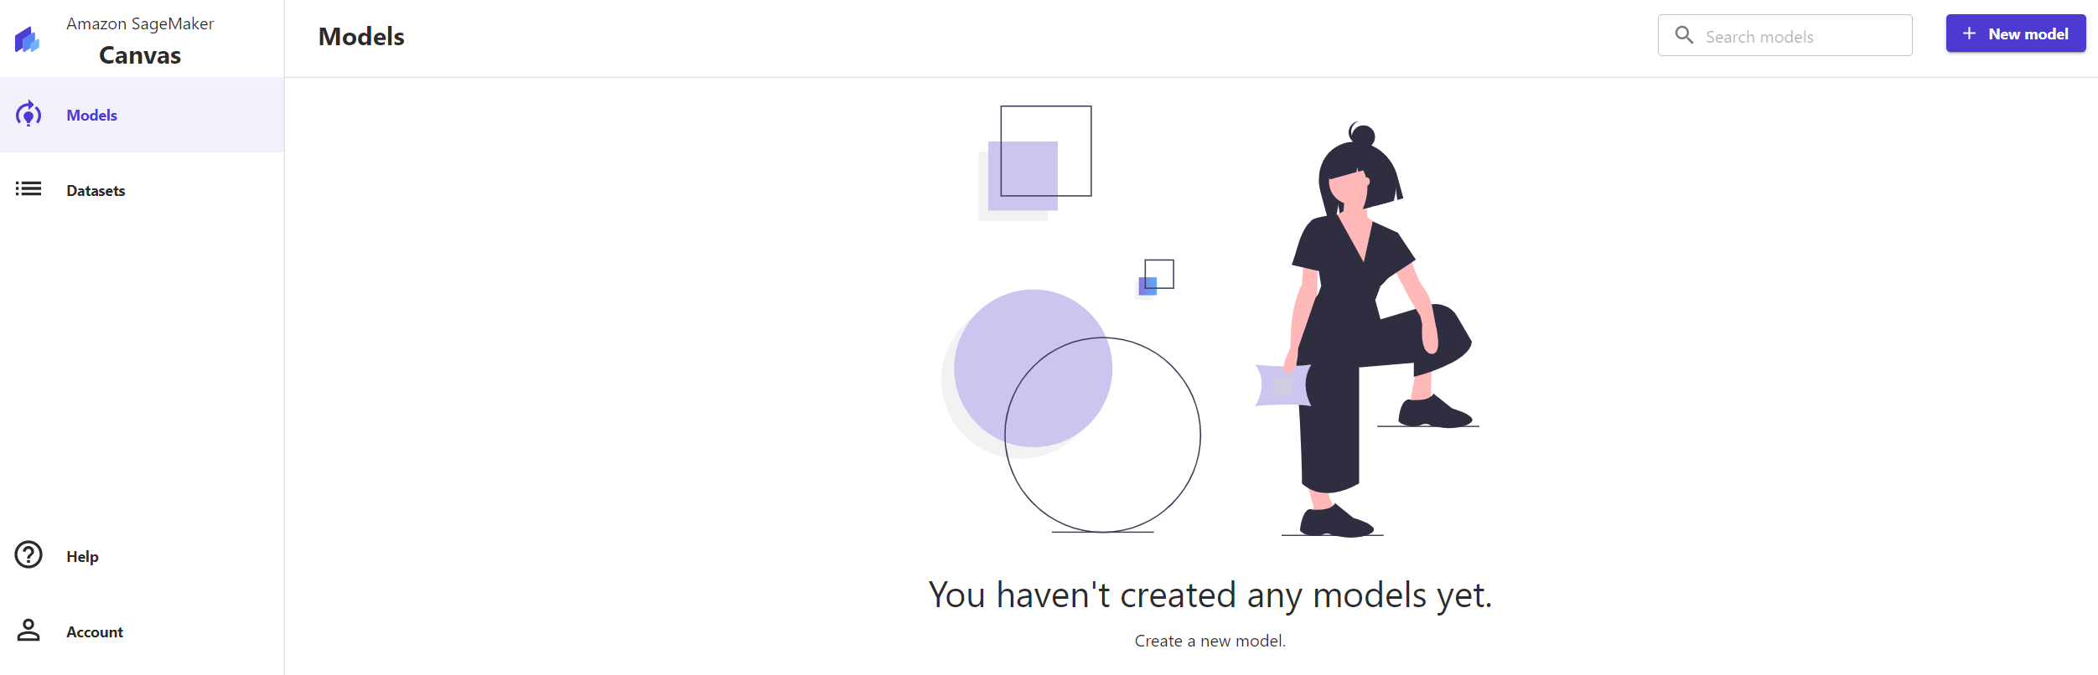
DEMO: AWS SAGEMAKER
CLICK ON MODELS AND CLICK ON CREATE NEW MODEL

Slide 68
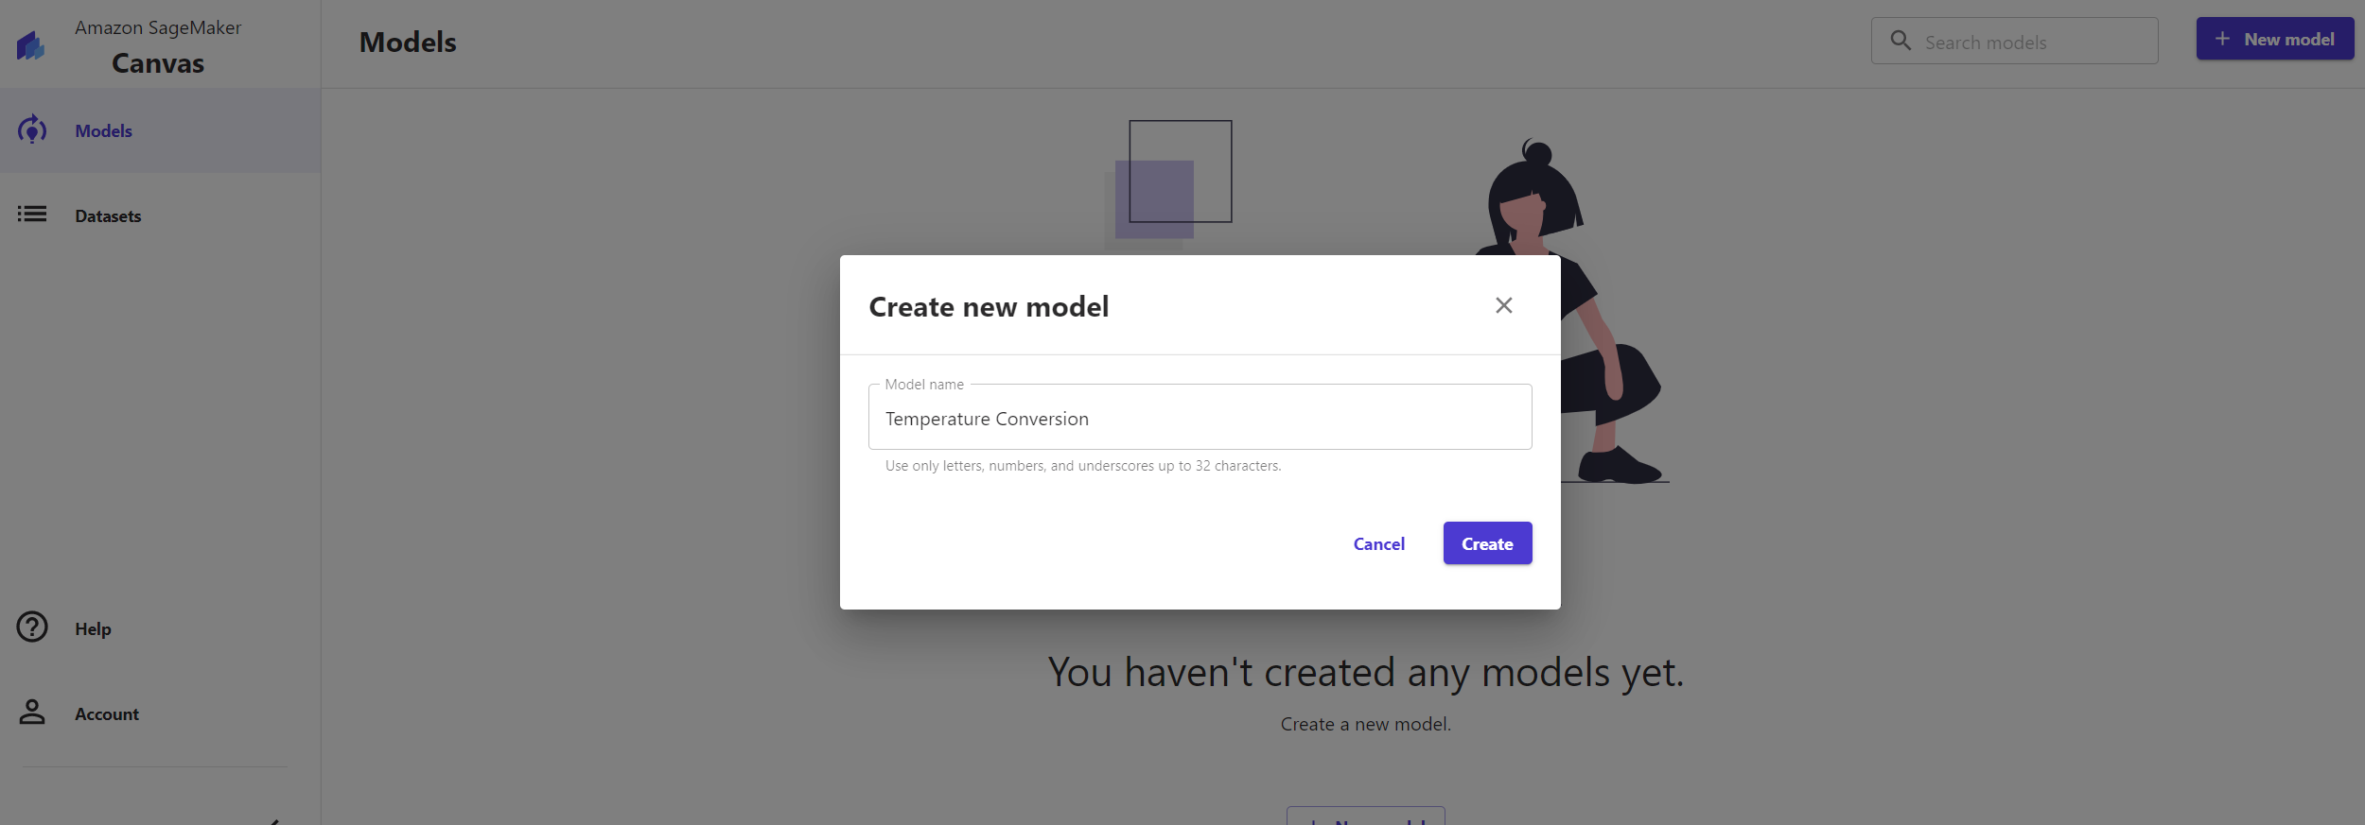
DEMO: AWS SAGEMAKER
PROVIDE A NAME TO THE MODEL AND CLICK CREATE

Slide 69

DEMO: AWS SAGEMAKER
SELECT THE DATASET

Slide 70

DEMO: AWS SAGEMAKER
YOU CAN VIEW THE FIRST 100 ROWS

Slide 71

DEMO: AWS SAGEMAKER
I WANT TO CONVERT FROM CELCIUS TO FAHRENHEIT SO SELECT FAHRENHEIT AS THE TARGET. CLICK ON QUICK BUILD.

Slide 72

DEMO: AWS SAGEMAKER
MODEL IS NOW BEING BUILT!

Slide 73

DEMO: AWS SAGEMAKER
PREDICTED VS. ACTUAL! NOTE THAT THIS IS A SIMPLE STARTER MODEL AND WE DIDN’T REALLY NEED TO USE ML HERE! IN THE FUTURE WE WILL BUILD MUCH MORE ADVANCED MODELS!

Slide 74

DEMO: AWS SAGEMAKER
SELECT A TEMPERATURE IN CELCIUS AND CLICK UPDATE TO GENERATE A PREDICTION IN FAHRENHEIT

Slide 75

DEMO: AWS SAGEMAKER
SELECT ANOTHER NUMBER AND PERFORM A SANITY CHECK!

Slide 76

DEMO: AWS SAGEMAKER
NOW YOU CAN SEE THE MODEL

Slide 77
FINAL CAPSTONE PROJECT
EASY
ADVANCED

Slide 78


PROJECT OVERVIEW: EMPLOYEE SALARY PREDICTION
In this project, we will train a simple machine learning model to predict employee salary based on the number of years of experience using Amazon SageMaker Canvas.
1. Upload the “salary.csv” data to S3
2. Select the target column and plot its distribution
3. Build a new Machine Learning model using Amazon SageMaker Canvas
4. Analyze the results, what’s the accuracy of the trained model?
5. Test the trained model performance using at least 3 sample years of experience.

Slide 79
FINAL CAPSTONE PROJECT SOLUTION
EASY
ADVANCED

Slide 80

DEMO: AWS SAGEMAKER
UPLOAD THE SALARY.CSV DATA TO S3

Slide 81

DEMO: AWS SAGEMAKER
CREATE A NEW MODEL AND NAME IT SALARY PREDICTION

Slide 82

DEMO: AWS SAGEMAKER
IMPORT SALARY DATA

Slide 83

DEMO: AWS SAGEMAKER
SELECT SALARY AS THE TARGET COLUMN AND CLICK ON QUICK BUILD

Slide 84

DEMO: AWS SAGEMAKER
MODEL PREDICTIONS VS. ACTUAL VALUES

Slide 85

DEMO: AWS SAGEMAKER
CLICK ON ADVANCED METRICS

Slide 86

DEMO: AWS SAGEMAKER
SELECT SINGLE PREDICTION AND CHOOSE A NUMBER OF YEARS OF EXPERIENCE TO PREDICT SALARY

